Slide 1
Apache Airavata Open Source Framework
Marcus Christie, Indiana University

Slide 2
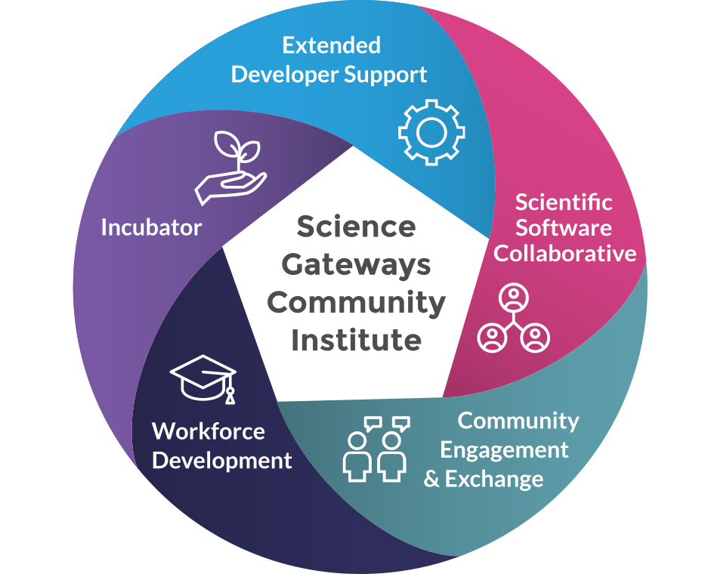
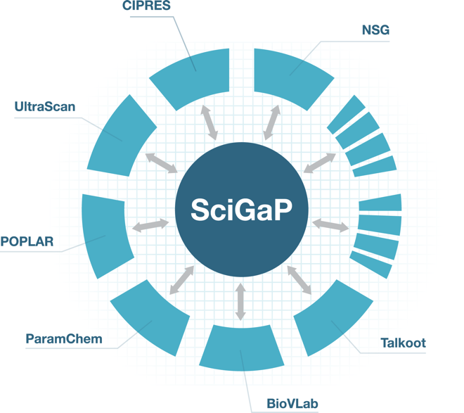
About Myself

Slide 3
Overview
What is Airavata?
What can you build with it?
Future Directions

Slide 4
History of Airavata - LEAD
Notes:
Airavata started as a set of distributed services developed to solve the science problems of the LEAD project
5-year National Science Foundation Large Information Technology Research (ITR) grant
mesoscale weather events
from static to dynamic configurations and workflows

Slide 5
History of Airavata - Apache
Suresh Marru worked on getting the LEAD project code donated to Apache
Apache Airavata is born
Open development process
“Community over code”

Slide 6
What Does Apache Airavata Do?
Airavata runs computational experiments
This means
Encoding how to run a wide range of scientific applications on a wide range of resources
Staging inputs and outputs to target resources
Monitoring long running applications
And most importantly...
Managing all the data and metadata generated by these experiments
Notes:
Airavata is a framework for building science gateways but what it means to be a science gateway has changed and will continue to evolve over time and Airavata continues to evolve
Airavata’s main capability is the ability to run computational experiments
The metadata and data maintained allows for reproducibility and sharing of results

Slide 7
Job submission - API Server
TODO: animation of launch experiment request
Notes:
API server exposes an API defined by Thrift IDL for interacting with Airavata
The API method to save and launch an experiment requires an ExperimentModel data structure, also defined by Thrift IDL
API server saves experiment in registry server
API server adds a message to the experiment launch queue

Slide 8
Job submission - Orchestrator
TODO: animation of Orchestrator handling launch request
Notes:
(Progressively add to the diagram over several slides)
Orchestrator listens to the experiment launch queue
Validates experiment
Figures out set of tasks needed to execute the experiment, creates a Process
Adds a message to the process launch queue

Slide 9
Job submission - GFac
TODO: animation of GFac running the experiment
Notes:
Listens to the process launch queue
Runs each task in the DAG in turn
Looks up in the registry to find out how to submit jobs, how to run an application, etc.
Uses SSH/SCP for job submission and data movement
Uses email monitoring to monitor the job
Updates the experiment in the registry

Slide 10
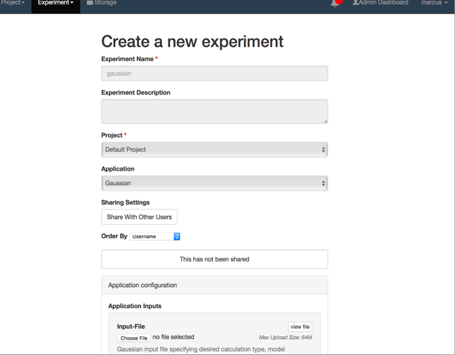
Airavata API
Notes:
Can generate client libraries for any number of languages using Apache Thrift
Examples of clients written in Java, PHP and Python

Slide 11
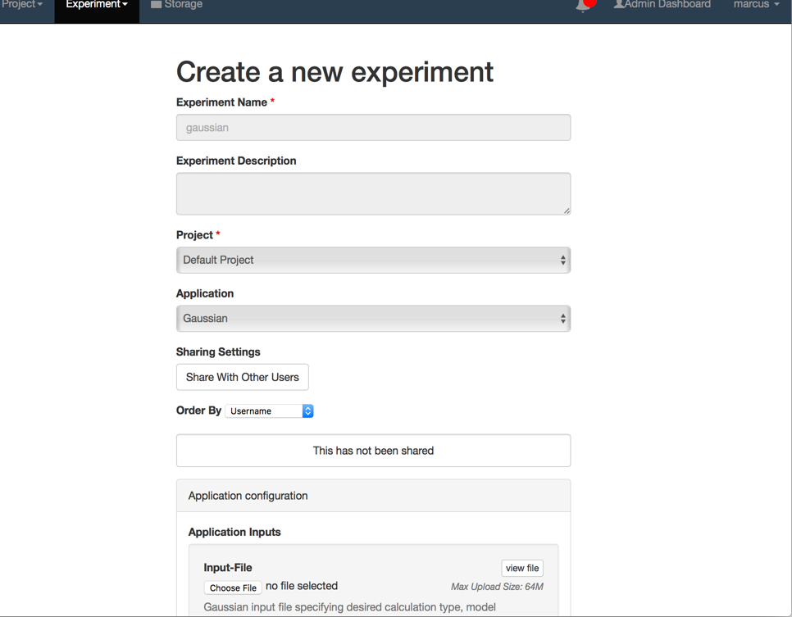
PGA – reference implementation
Notes:
PGA is built on Laravel a PHP framework
Showcases the functionality that is exposed by Airavata
Was originally intended as an example but it’s become the primary UI

Slide 12
Security - Keycloak
Notes:
open source service for identity and access management
Airavata uses this for user authentication, using OpenID Connect protocol
Think: “sign in with Google”
http://www.keycloak.org/
Red Hat, 200+ contributors on GitHub, 4,500+ merged PRs
Open source (ALv2) identity and access management server
Identity brokering; pluggable authentication mechanisms
Authorization services
Multi-tenanted
Complete, well documented REST API

Slide 13
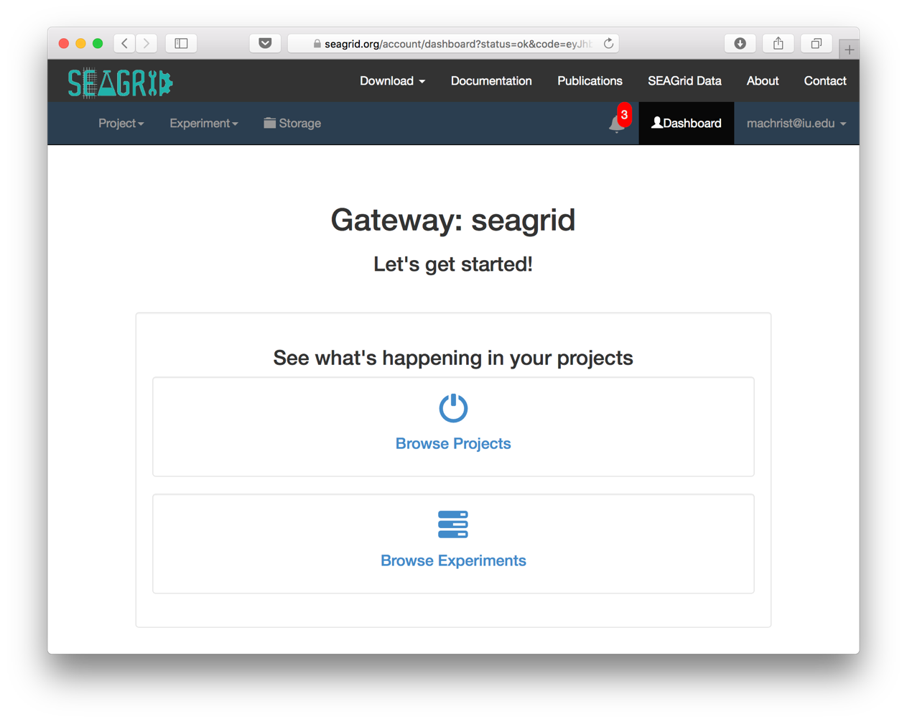
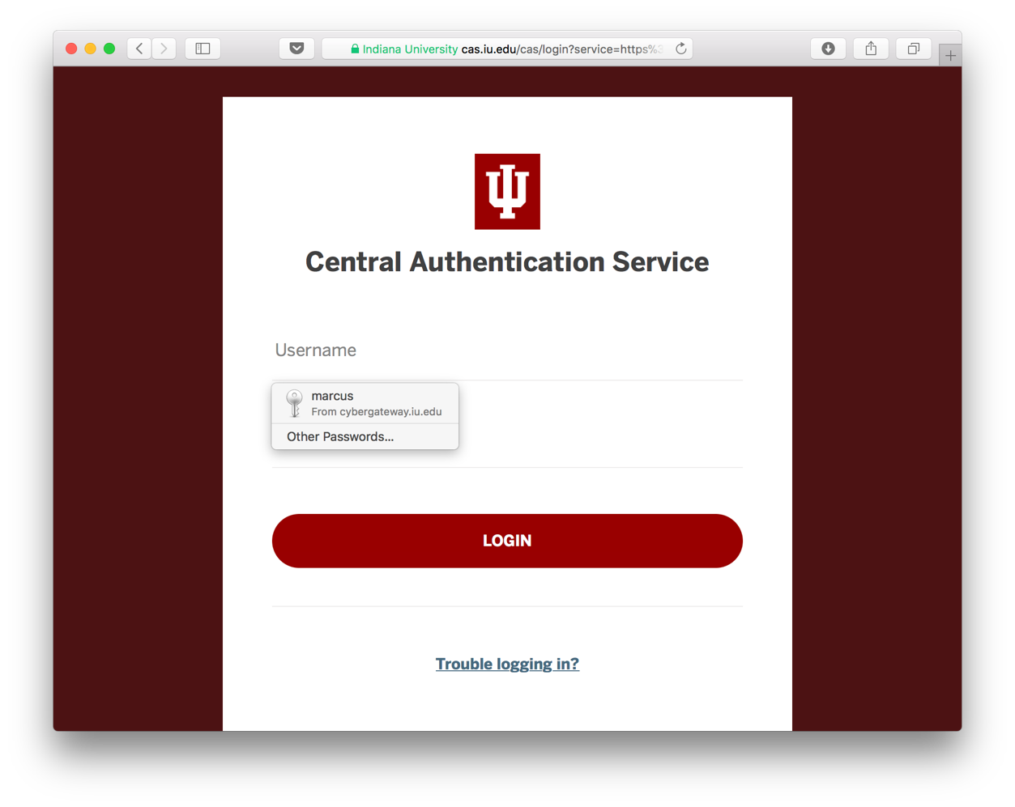
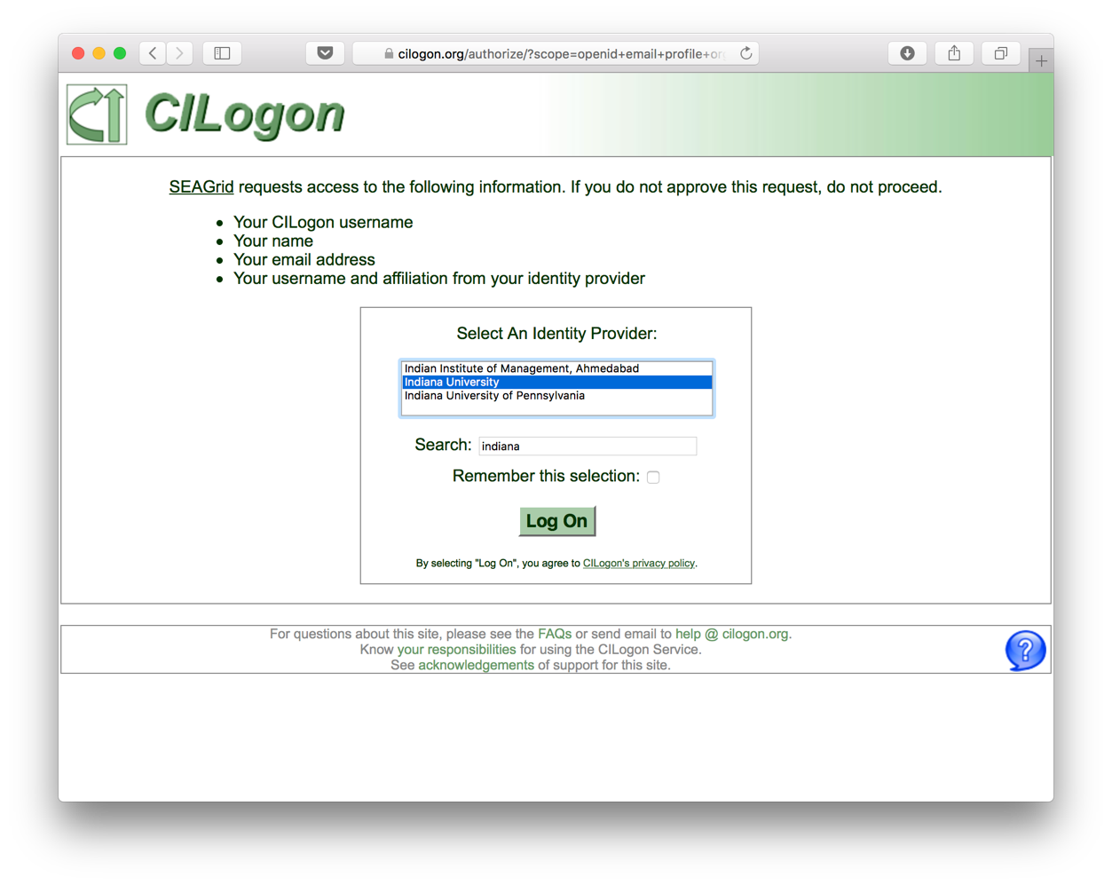
Security – Keycloak + CILogon
Notes:
CILogon federates authentication to several universities and institutions

Slide 14
Security – Credential Store
Notes:
Stores SSH key pairs and passwords
MariaDB database, records are encrypted
API server doesn’t allow getting the private keys or passwords but internally these are available

Slide 15
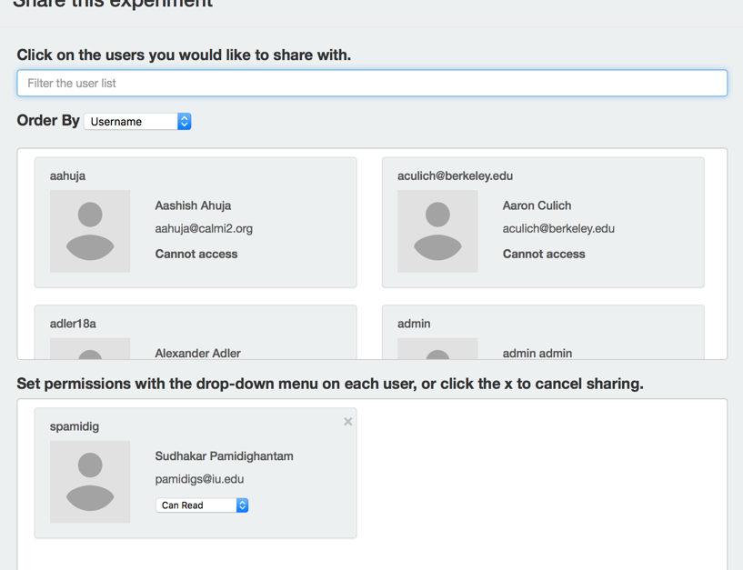
Sharing service
Sharing
Entity
Permission
Group
Notes:
What things are shared in Airavata?
Today:
Projects
Experiments
Files
Soon:
Compute Resources/Allocations
Applications

Slide 16
Scaling Airavata
Multi-tenancy – can run several gateways on the same set of Airavata services
DevOps – Ansible scripts automate deployment and updates of gateways
Notes:
This makes it easy for us in SciGaP to host lots of gateways.

Slide 17
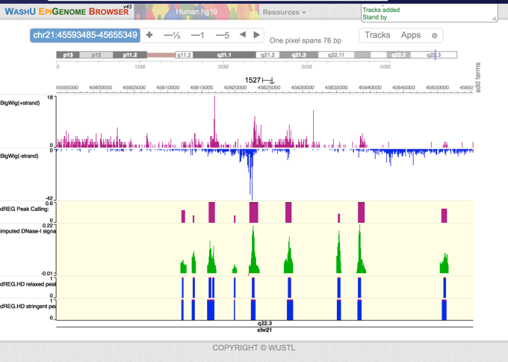
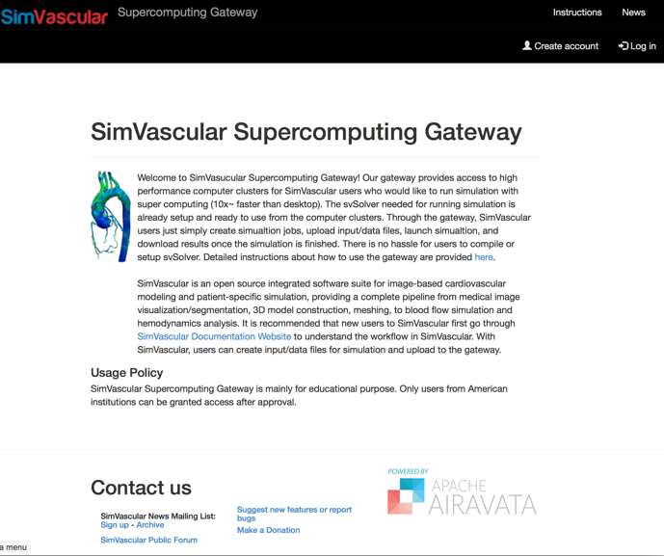
Science Gateways built on Airavata

Slide 18
Some Gateway Types
Software as a Service Gateways
Broaden access to your scientific software
Simplify user support
Domain Gateways
Provide access to many tools across a scientific domain
Integrate many different computing resources
Campus Gateways
Simplify and broaden access to campus resources
Bridge between campus, regional, and national resources
Classroom Gateways
Deliver scientific applications to students
Create and share Airavata experiments
Apache Airavata provides a platform for these types of gateways
Notes:
SaaS - you want to allow users to use your software without needing to install and update it themselves
Science Domain gateways - integrate domain specific tools with support for running computational jobs
Campus gateways - or more broadly, computational resource gateways, or still more broadly, physical resource gateways, you have some sort of physical resource you want to share, could be an instrument
Classroom gateways - multiple distinct groups of users are using your gateway to more easily run simulations and share them

Slide 19
dREG: discriminative Regulatory Element detection from GRO-seq
Prof. Charles Danko and Dr. Zhong Wang, Cornell
dREG: Identification of the genomic regions that regulate transcription
Genetic basis of many diseases
Code is actively developed
You may not have local resources for running it.
Traditional MPI and GPU versions

Slide 20
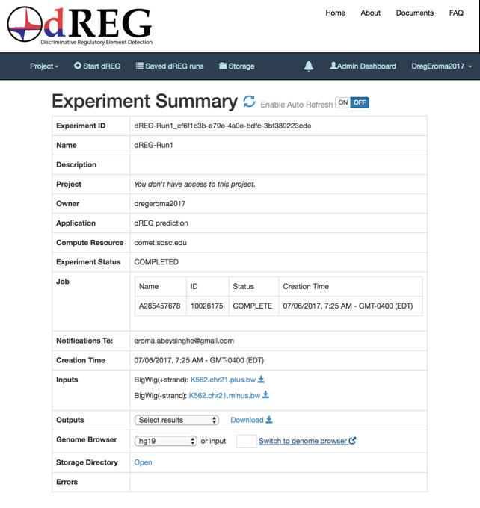
dREG: Software as a Service
Instead of requiring users to download and install the code, deliver it through a gateway.
And integrate third party Web tools

Slide 21
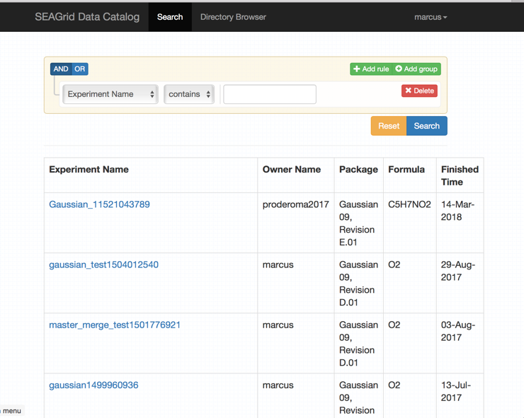
SEAGrid – Science Domain Gateway
Notes:
Desktop client integrates molecule editors and application frontends
data.seagrid.org provides data parsing and searching

Slide 22
University of South Dakota Campus Gateway
Provide simplified access to campus computing resources
Use campus identities all the way through (no community accounts)
Simplify bridging between campus resources and XSEDE.

Slide 23
Simvascular – Classroom Gateway

Slide 24
Airavata as a Platform
Django Portal
Helix based task execution
Group based authorization

Slide 25
Django Portal
Portal Page
Django
Python High level API
Airavata API Client
Dynamic UI
REST API
Airavata Middleware
CustUI Comp
Web Browser
Web Server

Slide 26
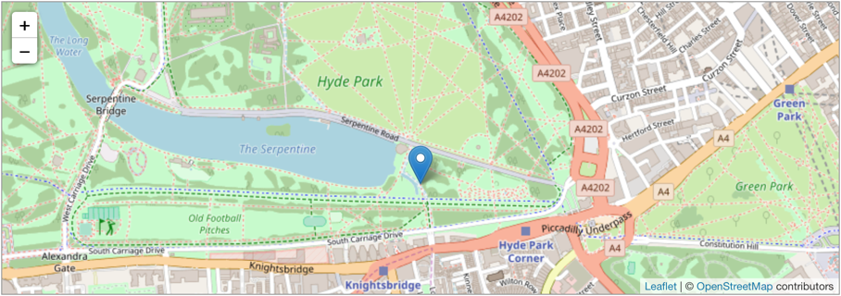
Custom UI Components
Image credit: leafletjs.com website
Image credit: jmol.sourceforge.net website
Notes:
Not just a reference implementation but a UI platform on which custom UI components can be built
Custom UI component types:
Application input editor
Application output visualizer
Custom application specific experiment editor

Slide 27
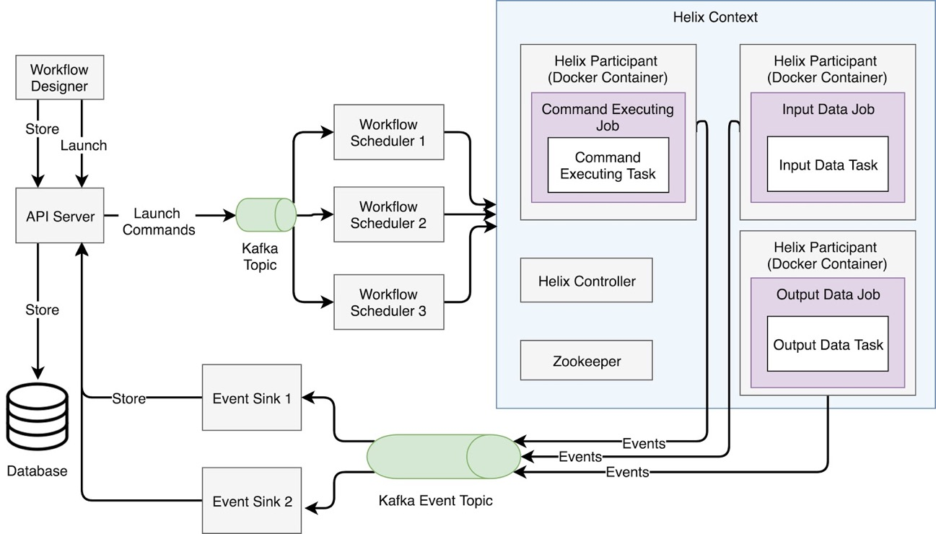
Helix-based Task Execution
Notes:
Apache Helix is “A cluster management framework for partitioned and replicated distributed resources”
The most relevant part of Helix for Airavata is the task framework
Helix task framework has a notion of workflows, jobs and tasks, and jobs can be arranged in a DAG to make a Workflow
Nodes that provide task implementation are called Participants
The idea is to put each Helix participant into its own Docker container, so each Task implementation is in its own container
This will simplify adding a new Task implementation, even into a production Airavata deployment
Helix will simplify creating new workflows out of existing Task implementations

Slide 28
Group-based Authorization
Currently, authorization based on statically defined roles
Group-based authorization gives gateway admins more fine-grained control
But also opens the door to allowing users to share resources and applications with other users
Notes:
Currently authorization is based on statically defined roles, leading to a hierarchical structure: only Gateway admins can add new applications or define and share resources.
Group based authorization will allow any user to create applications and resources in the gateway and share them with whomever they want
Also allows for more fine grained authorization, when a gateway admin wants to share an application or resource with only certain users

Slide 29
Conclusion
Apache Airavata has been used as the basis for several kinds of gateways
If you are interested in an Airavata gateway, we’re here to help
Get involved! Help shape the future of Airavata by contributing feedback and code.

Slide 30
More Information
Science Gateways Research Center
https://sgrc.iu.edu/
Apache Airavata Open Source Science Gateway Software
http://airavata.apache.org/
Create a free demo account at https://testdrive.airavata.org
Request a gateway at https://scigap.org
Contact
Center email: sgrc-iu-group@iu.edu
Marcus Christie: machrist@iu.edu
Marlon Pierce (Director): marpierc@iu.edu
Suresh Marru (Deputy Director): smarru@iu.edu
Notes:
I’ll just leave this slide up while I take questions

