Slide 1
Apache Airavata Open Source Framework
Marcus Christie, Indiana University

Slide 2
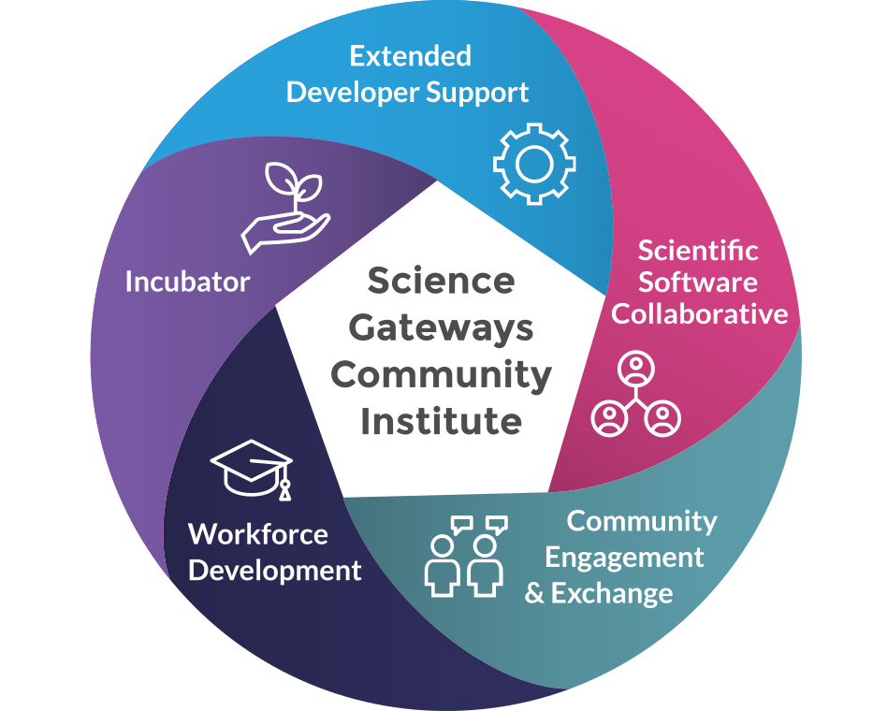
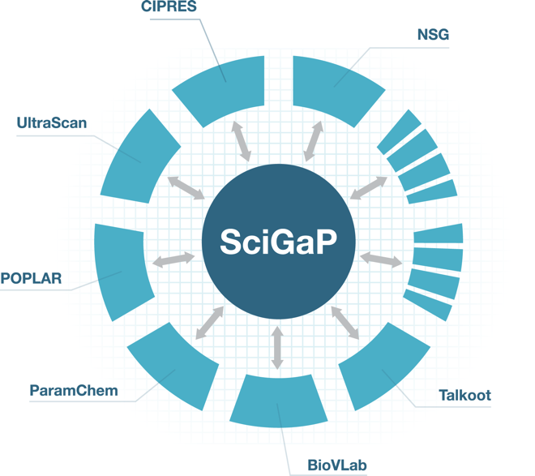
About Myself
Notes:
Committer and Project Management Committee (PMC) member of Apache Airavata
Help with operations of SciGaP, a science gateway hosting platform that scales to host many different science gateways
Member of the Extended Developer Support team of SGCI
Work in the Science Gateways Research Center at Indiana University

Slide 3
Overview
What is Airavata?
What can you build with it?
Future Directions

Slide 4
History of Airavata - LEAD
Notes:
* Airavata started as a set of distributed services developed to solve the science problems of the LEAD project
funded by a 5-year National Science Foundation Large Information Technology Research (ITR) grant; goal is to improve prediction of mesoscale weather events
The main research challenge with LEAD was to create cyberinfrastructure that is dynamically adaptive
For example, trigger a finer grained forecast when a storm signature is detected
* from static to dynamic configurations and workflows

Slide 5
History of Airavata - Apache
Suresh Marru worked on getting the LEAD project code donated to Apache Software Foundation
Apache Airavata is born
Open development process
“Community over code”
Notes:
LEAD Project ends
Open development process
Public mailing lists
Public issue tracker
Submit pull requests through GitHub
Community over code
More important to build a strong community than good code

Slide 6
What Does Apache Airavata Do?
Airavata runs computational experiments
This means
Encoding how to run a wide range of scientific applications on a wide range of resources
Staging inputs and outputs to target resources
Monitoring long running applications
And most importantly...
Managing all the data and metadata generated by these experiments
Notes:
Airavata is a framework for building science gateways but what it means to be a science gateway has changed and will continue to evolve over time and Airavata continues to evolve
Airavata’s main capability is the ability to run computational experiments
The metadata and data maintained allows for reproducibility and sharing of results

Slide 7
Job submission - API Server
Registry
Service
Thrift IDL
PHP
Registry DB
Java
PHP Gateway
Airavata
API Service
C++
Py
createExperiment(AuthzToken, ExperimentModel)
launchExperiment(AuthzToken, experimentId)
Experiment Launch queue
Notes:
API server exposes an API defined by Thrift IDL for interacting with Airavata
The API method to save and launch an experiment requires an ExperimentModel data structure, also defined by Thrift IDL
API server saves experiment in registry server
API server adds a message to the experiment launch queue

Slide 8
Job submission - Orchestrator
Registry
Service
Process
Working directory
Stage in
Submit job
Monitor
Stage out
Registry DB
Orchestrator
Experiment Launch queue
Process Launch queue
Notes:
(Progressively add to the diagram over several slides)
Orchestrator listens to the experiment launch queue
Validates experiment
Figures out set of tasks needed to execute the experiment, creates a Process
Adds a message to the process launch queue

Slide 9
Job submission - GFac
Registry
Service
Process
Update Experiment
Working directory
Stage in
Submit job
Monitor
Stage out
Application Catalog
Registry DB
GFac
SSH
Compute Resources
SCP
Email
Server
Process Launch queue
Notes:
Listens to the process launch queue
Runs each task in the DAG in turn
Looks up in the registry to find out how to submit jobs, how to run an application, etc.
Uses SSH/SCP for job submission and data movement
Uses email monitoring to monitor the job
Updates the experiment in the registry

Slide 10
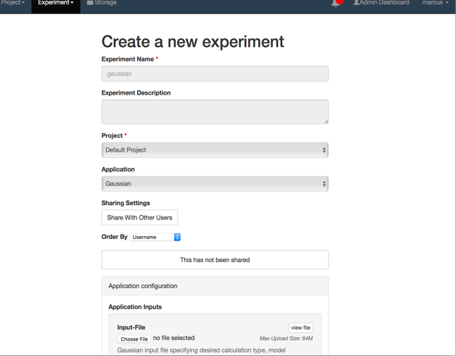
Airavata API
Notes:
Can generate client libraries for any number of languages using Apache Thrift
Examples of clients written in Java, PHP and Python

Slide 11
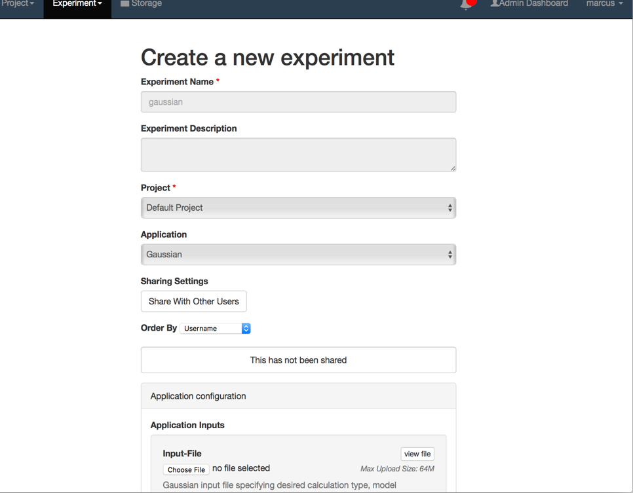
PGA – reference implementation
Notes:
PGA is built on Laravel a PHP framework
Showcases the functionality that is exposed by Airavata
Was originally intended as an example but it’s become the primary UI

Slide 12
Security - Keycloak
Notes:
Main point: Airavata clients and the API service need a service that they can trust for authentication and authorization
open source service for identity and access management
Airavata uses this for user authentication, using OpenID Connect protocol
Think: “sign in with Google”
http://www.keycloak.org/
Red Hat, 200+ contributors on GitHub, 4,500+ merged PRs
Open source (ALv2) identity and access management server
Identity brokering; pluggable authentication mechanisms
Authorization services
Multi-tenanted
Complete, well documented REST API
Authorization flow
Once user logs in, Keycloak returns (through OpenID Connect) an access token to PGA
Access token is included in every request to the Airavata API server
API Server makes a call to Keycloak to validate the access token
API Server uses Keycloak REST API to get a list of roles that the user has
API Server then checks to make sure that the user has the necessary role to call that API method

Slide 13
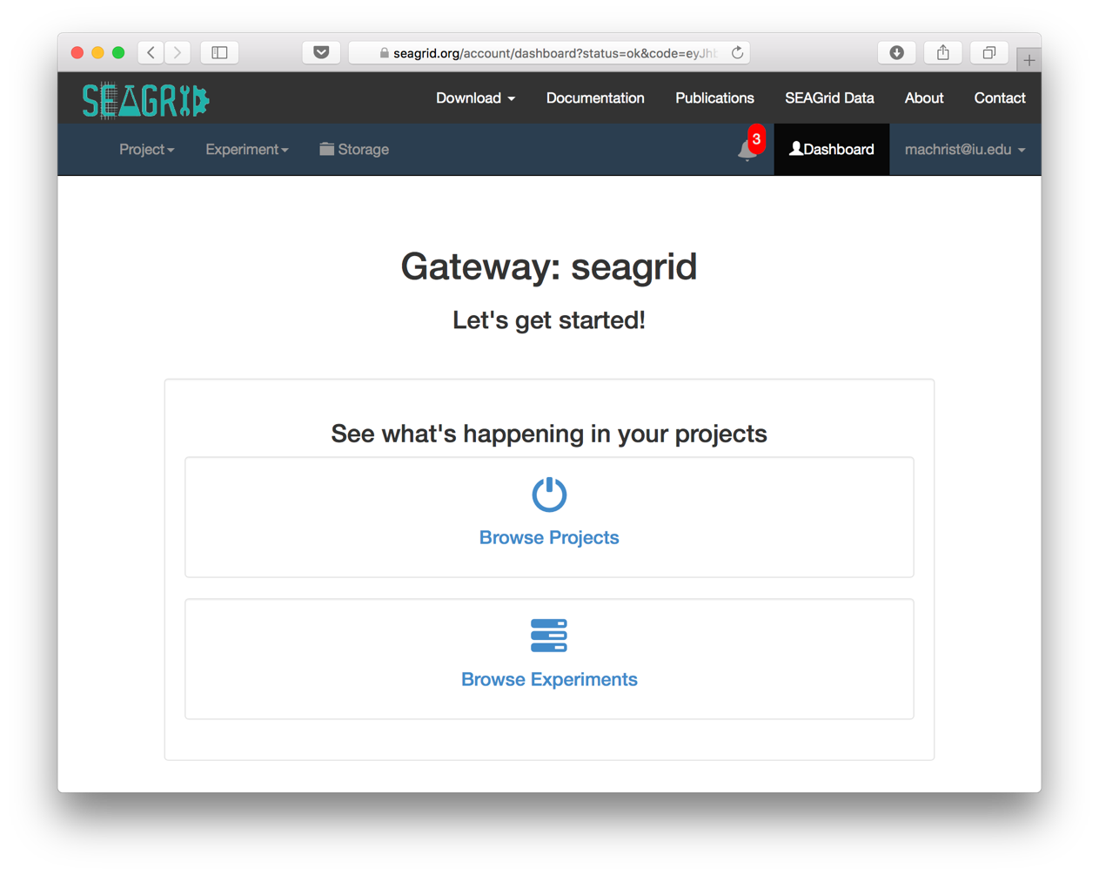
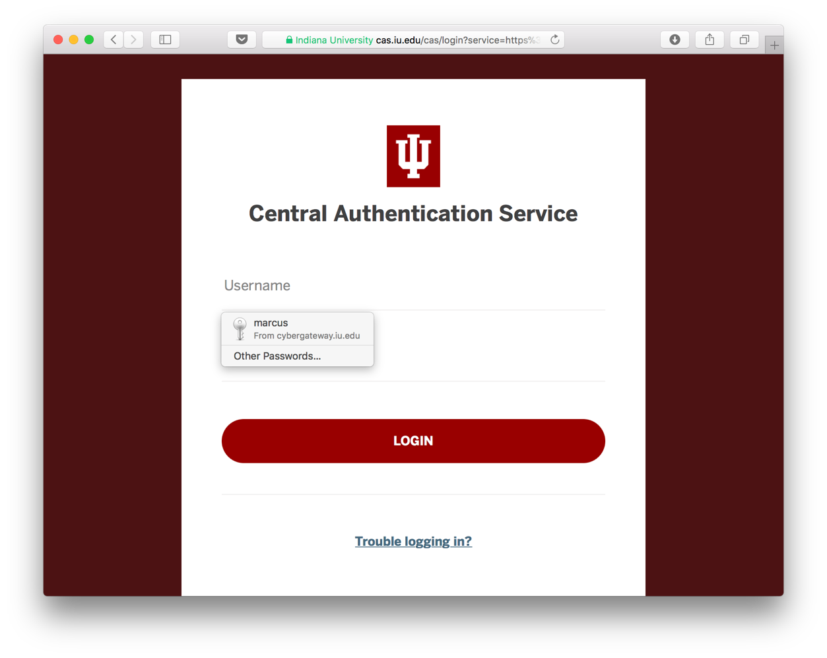
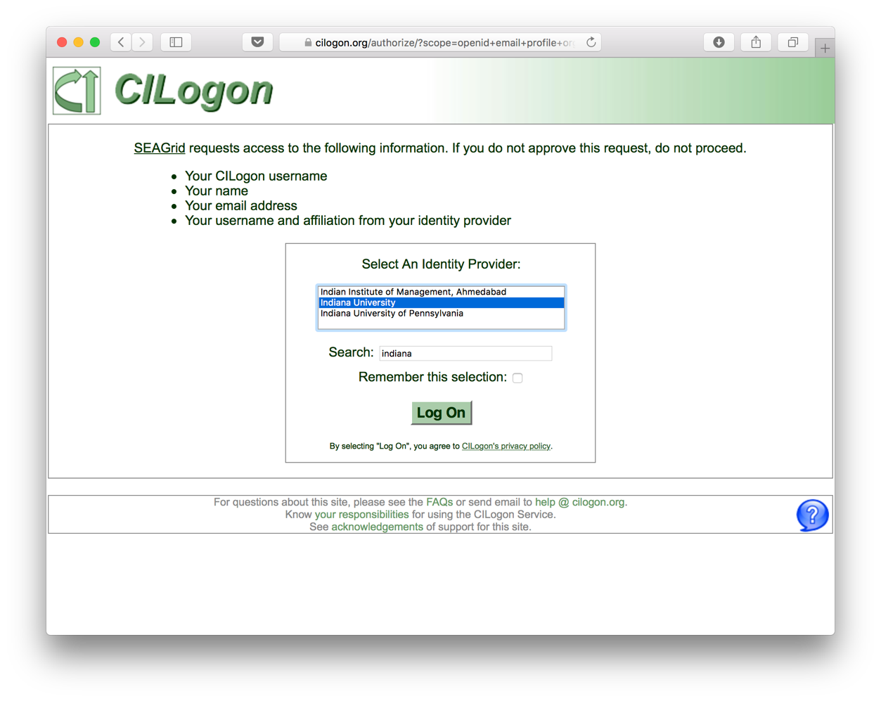
Security – Keycloak + CILogon
Notes:
CILogon federates authentication to several universities and institutions
CILogon is a member of InCommon and provides an OpenID Connect bridge to the InCommon’s SAML based authentication federation

Slide 14
Security – Credential Store
Notes:
Stores SSH key pairs and passwords
MariaDB database, records are encrypted
API server doesn’t allow getting the private keys or passwords but internally these are available

Slide 15
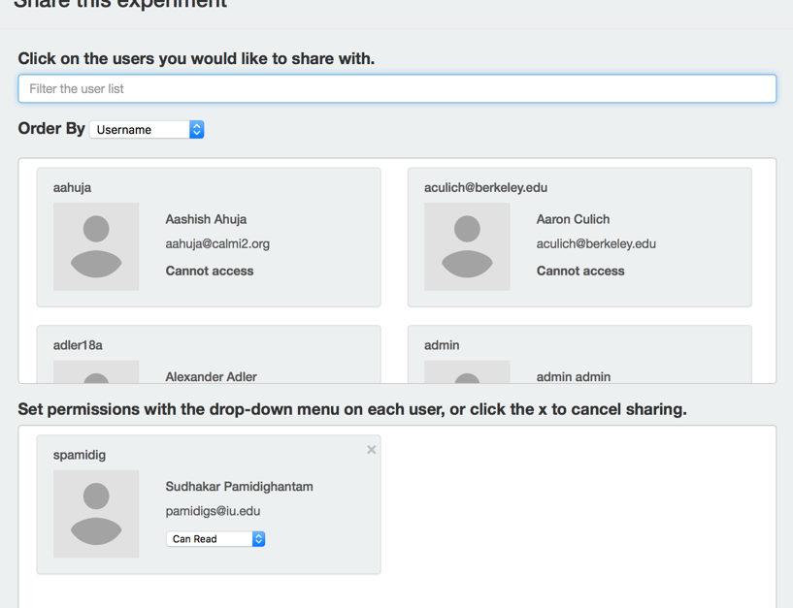
Sharing service
Sharing
Entity
Permission
Group
Notes:
Entity represents a thing that can be shared
A “sharing” is a triple of an entity, a group and a permission
Example: a student shares her experiment with other students in the class with the READ permission so they can see the results
What things are shared in Airavata?
Today:
Projects
Experiments
Files
Soon:
Compute Resources/Allocations
Applications

Slide 16
Scaling Airavata
Multi-tenancy – can run several gateways on the the same installation of Airavata services
DevOps – Ansible scripts automate deployment and updates of gateways
Notes:
Scaling here means decreasing the marginal cost of adding a new gateway, in terms of IT resources and human resources
Multi-tenancy means that a single Airavata installation can host several science gateways
The distinguishing attribute is what we call the gateway id
Ansible scripts automate deployment and update steps that were previously done manually
Together these allow the managers of a single installation of Airavata to easily scale to hosting several science gateways
The marginal cost to adding another gateway is extremely low
This makes it easy for us in SciGaP to host lots of gateways

Slide 17
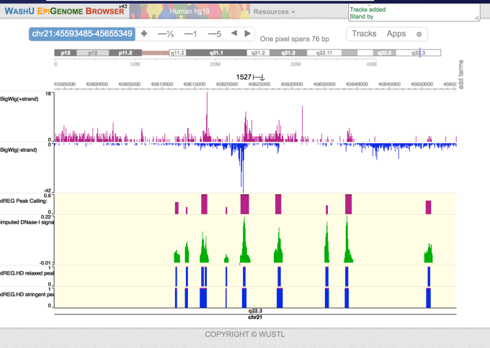
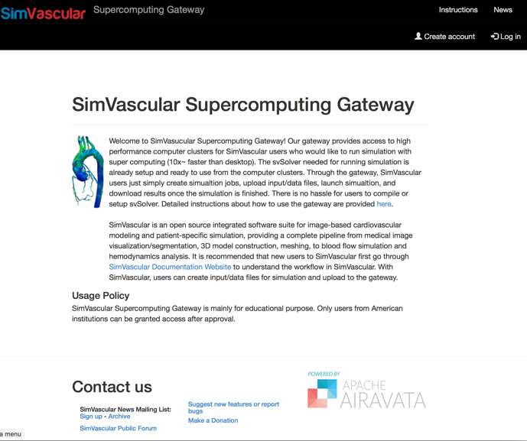
Science Gateways built on Airavata

Slide 18
Some Gateway Types
Software as a Service Gateways
Broaden access to your scientific software
Simplify user support
Domain Gateways
Provide access to many tools across a scientific domain
Integrate many different computing resources
Campus Gateways
Simplify and broaden access to campus resources
Bridge between campus, regional, and national resources
Classroom Gateways
Deliver scientific applications to students
Create and share Airavata experiments
Apache Airavata provides a platform for these types of gateways
Notes:
SaaS - you want to allow users to use your software without needing to install and update it themselves
Science Domain gateways - integrate domain specific tools with support for running computational jobs
Campus gateways - or more broadly, computational resource gateways, or still more broadly, physical resource gateways, you have some sort of physical resource you want to share, could be an instrument
Classroom gateways - multiple distinct groups of users are using your gateway to more easily run simulations and share them

Slide 19
dREG: discriminative Regulatory Element detection from GRO-seq
Prof. Charles Danko and Dr. Zhong Wang, Cornell
dREG: Identification of the genomic regions that regulate transcription
Genetic basis of many diseases
Code is actively developed
You may not have local resources for running it.
Traditional MPI and GPU versions
Notes:
dREG application predicts the location of the parts of a genome that regulate transcription of DNA into RNA, using machine learning techniques
Software is actively developed and optimized for running on a GPU cluster
Gateway provides
Easy access to running dREG
Access to running on a fast GPU cluster
Pre-trained machine learning models

Slide 20
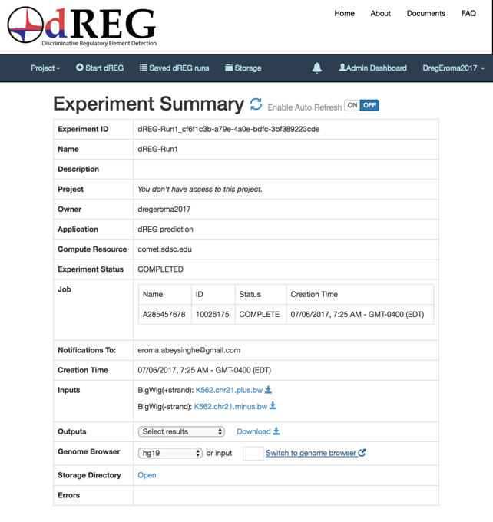
dREG: Software as a Service
Instead of requiring users to download and install the code, deliver it through a gateway.
And integrate third party Web tools
Notes:
Zhong modified the PGA code to link the output data files to an online genome browser

Slide 21
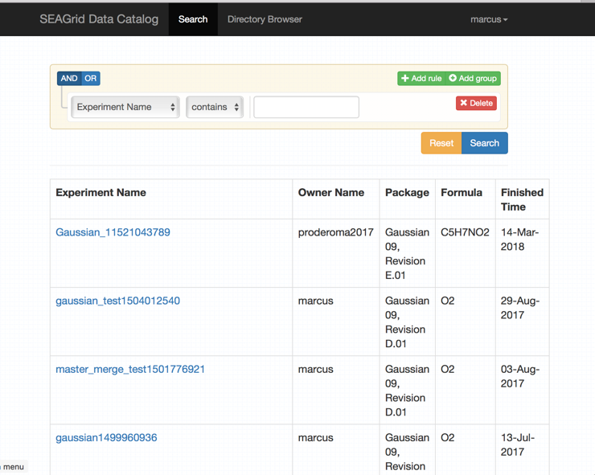
SEAGrid – Science Domain Gateway
Notes:
Desktop client integrates molecule editors and application frontends
data.seagrid.org provides data parsing and searching

Slide 22
University of South Dakota Campus Gateway
Provide simplified access to campus computing resources
Use campus identities all the way through (no community accounts)
Simplify bridging between campus resources and XSEDE.
Notes:
Doug Jennewein, director of research computing at USD, pictured on the right
A campus gateway is a science gateway that shares campus resources

Slide 23
SimVascular – Classroom Gateway
Notes:
SimVascular Is an open source integrated software suite for cardiovascular modeling and simulation
Gateway already has svSolver software installed and configured on a cluster
Classrooms using SimVascular gateway can also benefit from the sharing capabilities
Going forward, we’re working on the following:
Allow faculty to share their allocation with their own students
Allow faculty the ability to manage their students’ user accounts

Slide 24
Airavata as a Platform
Django Portal
Helix based task execution
Group based authorization
Notes:
* Instead of only using Airavata as an API, also use it as a platform on which to build new functionality
* We'll look at how each of these three areas of active develop contribute to this idea

Slide 25
Django Portal
Portal Page
Django
Python High level API
Airavata API Client
Dynamic UI
REST API
Airavata Middleware
CustUI Comp
Web Browser
Web Server
Notes:
* We're reimplementing the PGA as a Django web application, but now no longer a reference implementation, instead a UI platform
* Each portal page contains dynamic UI components that talk to a REST API that bridges calls to the Airavata API
* With a real UI component model, gateway developers will be able to create custom, domain-specific UI components

Slide 26
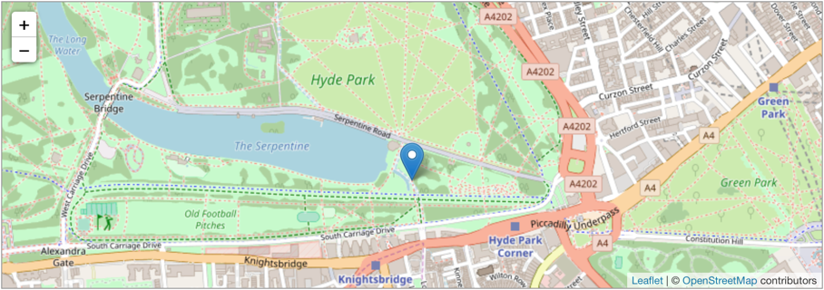
Custom UI Components
Image credit: leafletjs.com website
Image credit: jmol.sourceforge.net website
Notes:
Not just a reference implementation but a UI platform on which custom UI components can be built
Custom UI component types:
Application input editor
Application output visualizer
Custom application specific experiment editor

Slide 27
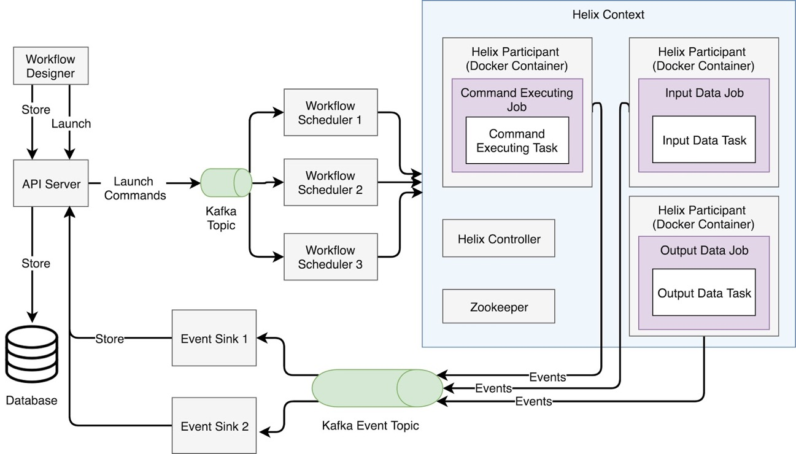
Helix-based Task Execution
Notes:
Apache Helix is “A cluster management framework for partitioned and replicated distributed resources”
The most relevant part of Helix for Airavata is the task framework
Helix task framework has a notion of workflows, jobs and tasks, and jobs can be arranged in a DAG to make a Workflow
Nodes that provide task implementation are called Participants
The idea is to put each Helix participant into its own Docker container, so each Task implementation is in its own container
This will simplify adding a new Task implementation, even into a production Airavata deployment
Helix will simplify creating new workflows out of existing Task implementations

Slide 28
Group-based Authorization
Currently, authorization based on statically defined roles
Group-based authorization gives gateway admins more fine-grained control
But also opens the door to allowing users to share resources and applications with other users
Notes:
Currently authorization is based on statically defined roles, leading to a hierarchical structure: only Gateway admins can add new applications or define and share resources.
Group based authorization will allow any user to create applications and resources in the gateway and share them with whomever they want
Also allows for more fine grained authorization, when a gateway admin wants to share an application or resource with only certain users

Slide 29
Conclusion
Apache Airavata has been used as the basis for several kinds of gateways
If you are interested in an Airavata gateway, we’re here to help
Get involved! Help shape the future of Airavata by contributing feedback and code.

Slide 30
More Information
Science Gateways Research Center
https://sgrc.iu.edu/
Apache Airavata Open Source Science Gateway Software
http://airavata.apache.org/
Create a free demo account at https://testdrive.airavata.org
Request a gateway at https://scigap.org
Contact
Center email: sgrc-iu-group@iu.edu
Marcus Christie: machrist@iu.edu
Marlon Pierce (Director): marpierc@iu.edu
Suresh Marru (Deputy Director): smarru@iu.edu
Notes:
I’ll just leave this slide up while I take questions

