Slide 1
Build a sample gateway using Apache Airavata Open Source Framework
Marcus Christie
Sudhakar Pamidighantam

Slide 2
What we’re going to do
Log into a demo gateway as an admin user
Register an application (NWChem)
Submit a NWChem experiment

Slide 3
What we’ve already done
Requested a gateway: https://scigap.org
Accepted and created the gateway
Deployed the gateway
Configured each gateway with a compute resource
This is the part that involves installing the SSH public key on the compute cluster
Half of the demo gateways use comet
Other half use stampede2

Slide 4
Requesting a gateway
https://scigap.org
Log in
Fill out a short form
Please provide a thoughtful Public Project Description
Whenever your request is updated you’ll receive an email

Slide 5
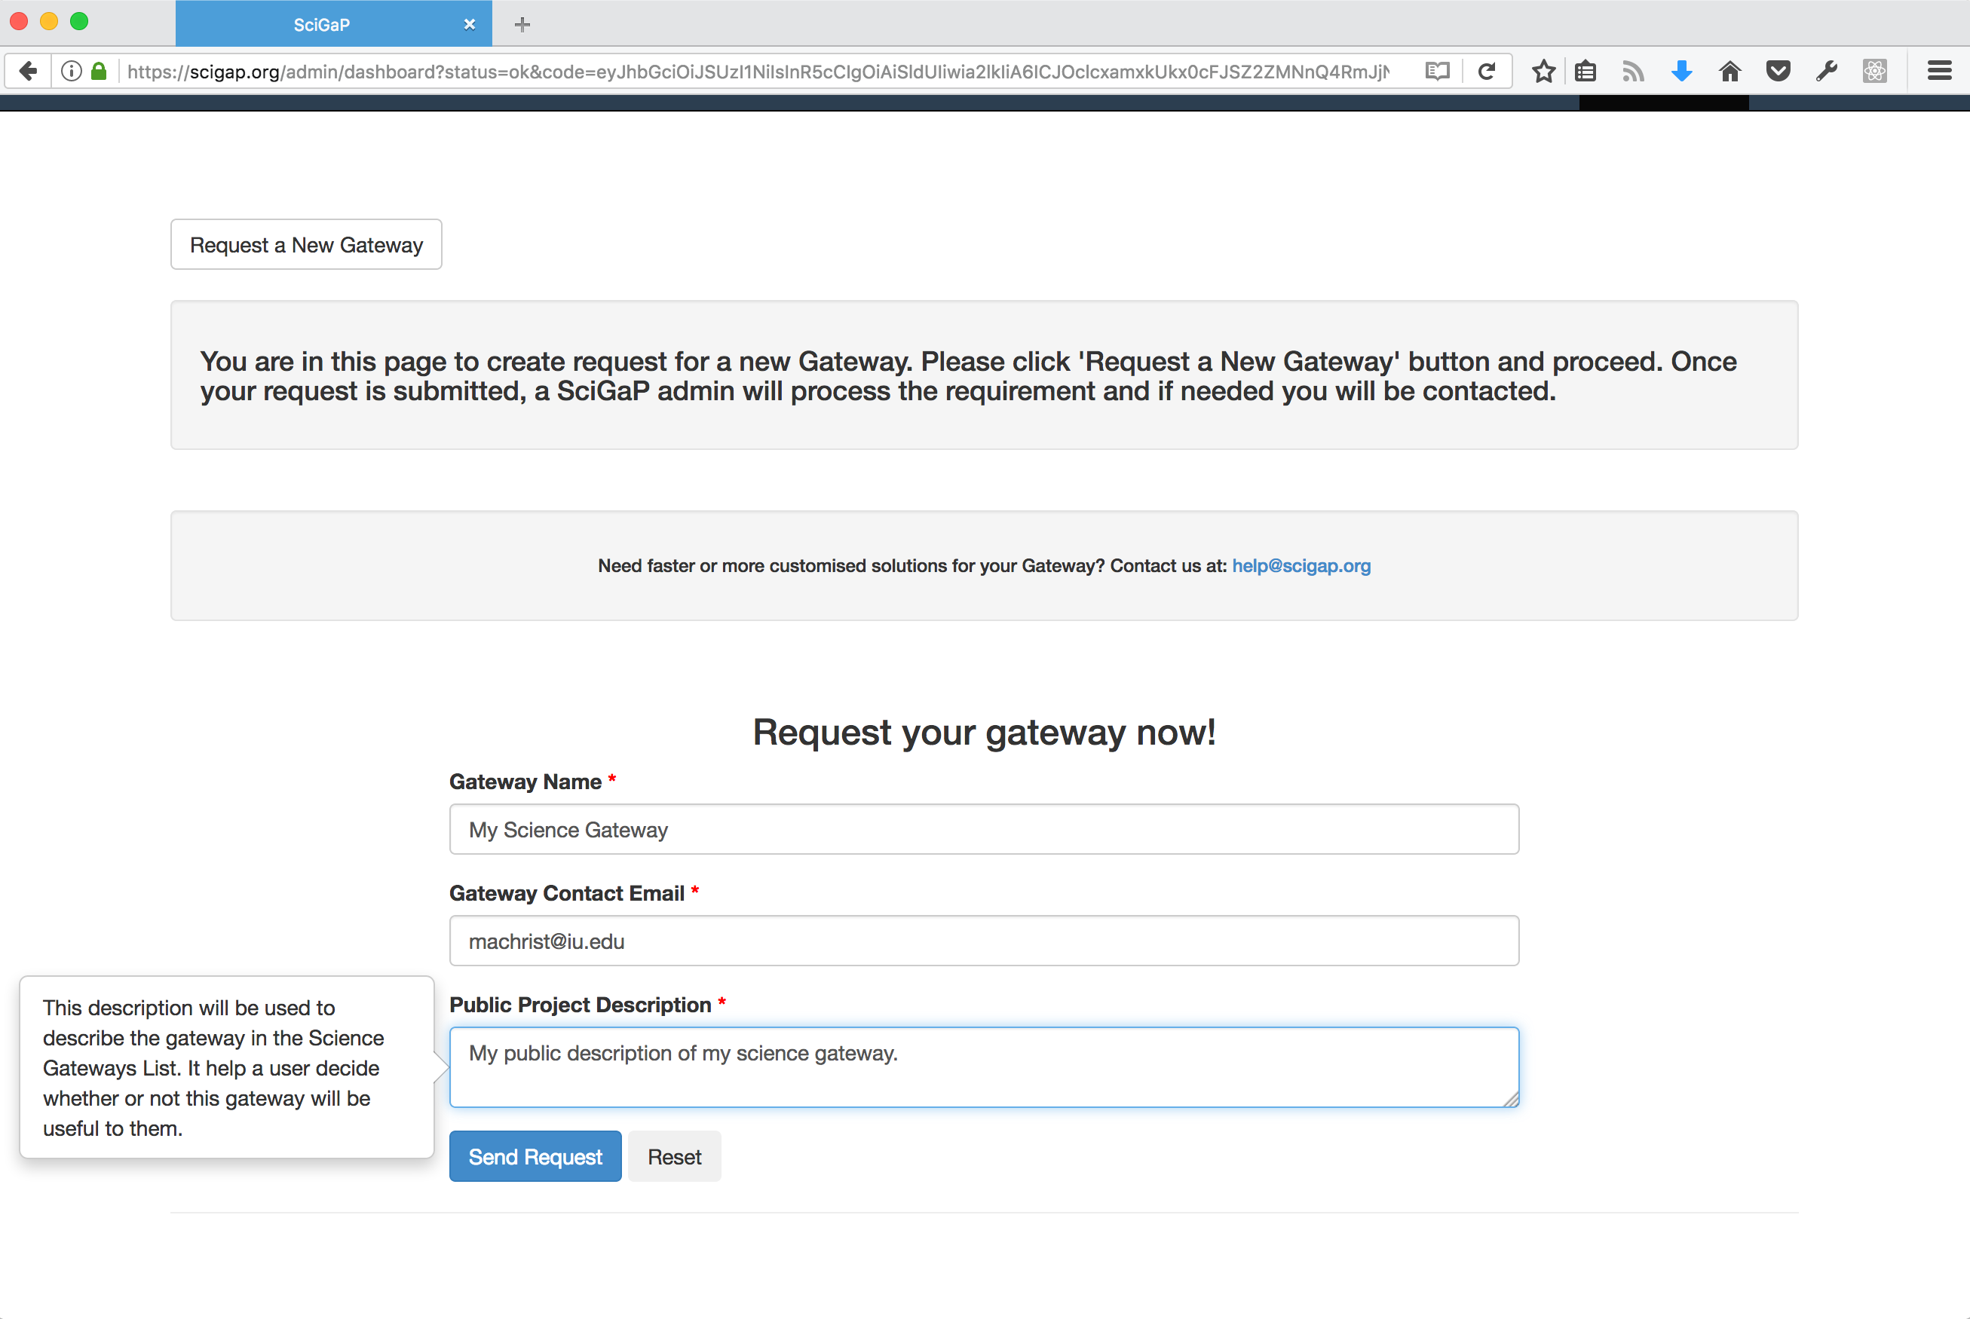
Gateway Request

Slide 6
Let’s get started!
Go to https://seagrid.org
Click on Documentation at the top
Click on SGCI-MOLSSI Workshop at the ACS National Meeting, New Orleans, Mar 19-22,2018
At the bottom, click on Exercise 1: Adding NWChem application in to the gateway

