Slide 1
SEAGrid Science Gateway and
Molecular Science Exemplars
Sudhakar Pamidighantam
Indiana University
pamidigs@iu.edu
SGCI-MolSSI– Workshop ACS National Meeting
New Orleans, 20 Mar 2018

Slide 2
Science Gateways
Web interfaces and middleware for integrating distributed computing, automating expertise, controlling access, managing results, and speeding up your critical computational workflows

Slide 3
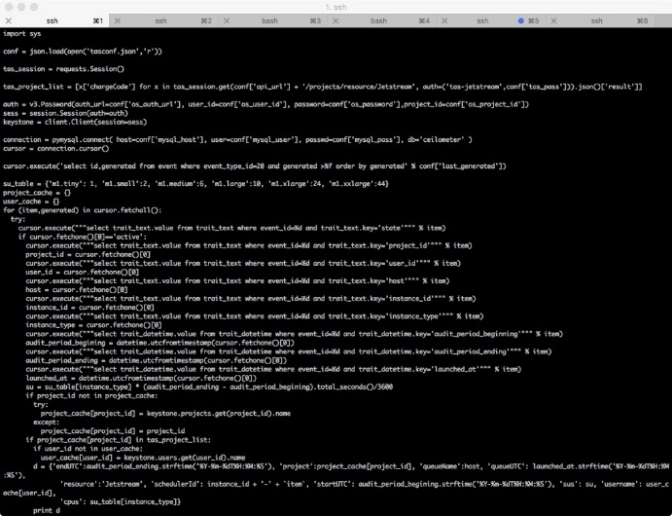
Technology Adoption Choices
Notes:
Jeff Z: Left: the code and the right is the user interface

Slide 4
What is a Science Gateway?
Science gateways are Web and desktop interfaces to high performance computing clusters, computing clouds.
Science gateways encode expertise
  Running specific scientific application
  Running jobs on diverse, nonlocal machines
  Moving data to and from world-wide resources
Science gateways enable sharing of results
Science gateways make results recoverable and reproducible

Slide 5
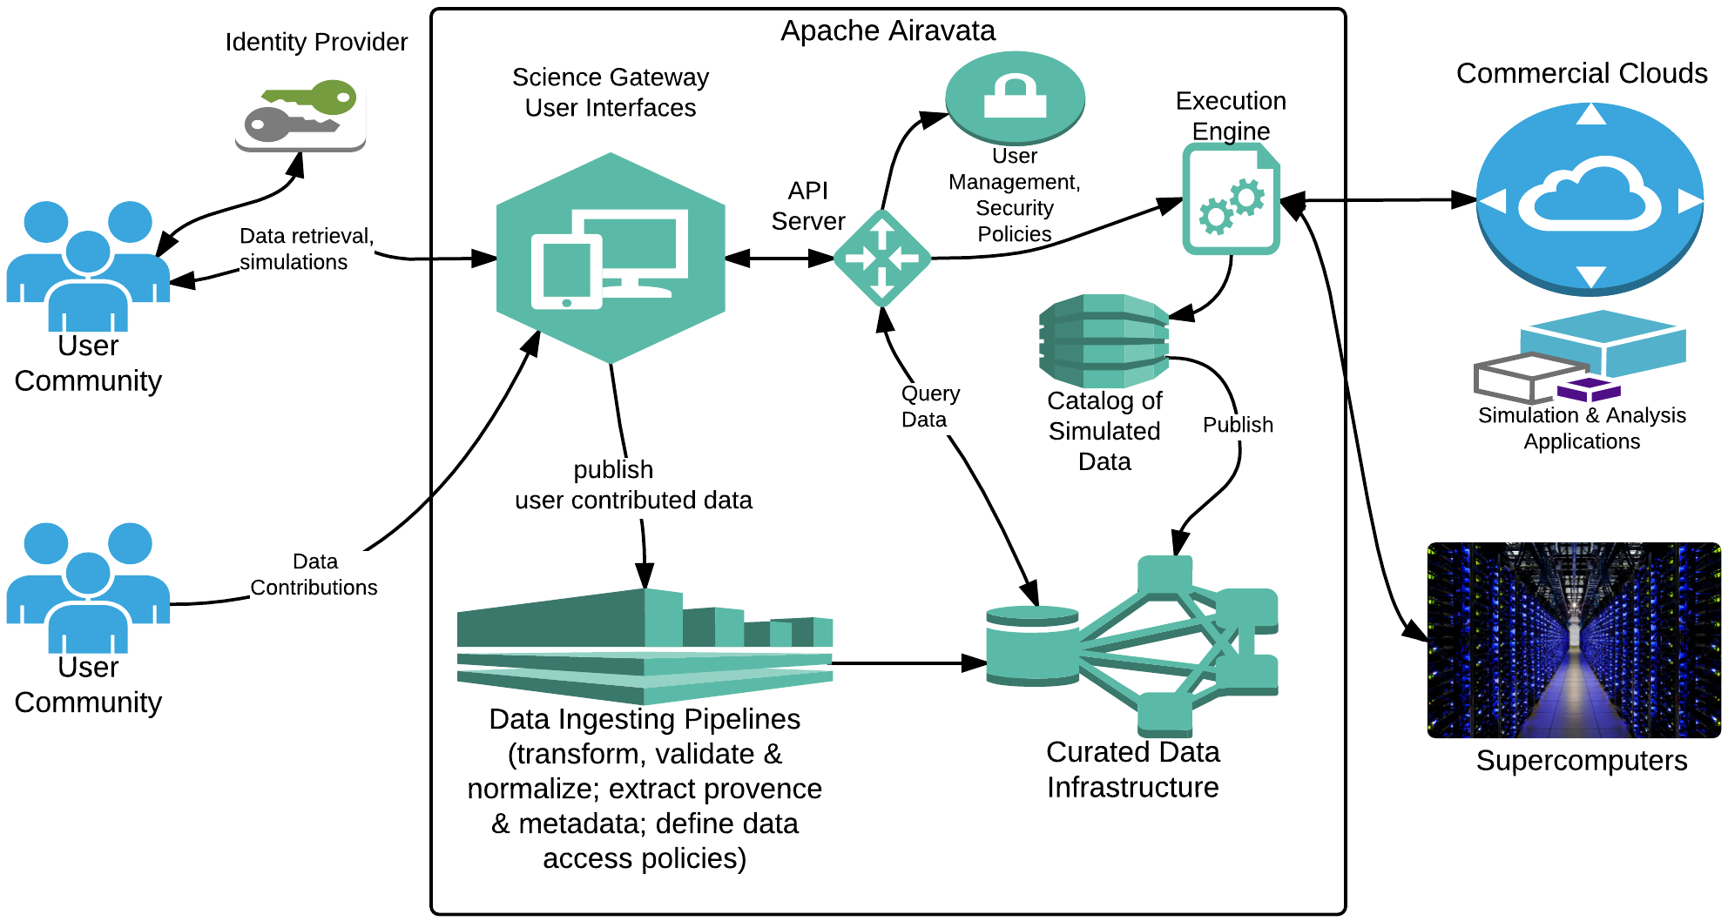
Science Gateway Architecture
Notes:
Jeff Z: Remove branding, remove Apache Airavata from box. Stay on message. Get rid of logos at the bottom, concentrate on content and message. Too much lingo. Concentrate on what you can do for the user. Extract provenance, metadata, data ingestion pipelines, etc are all terms that people won’t know.
Next slide: would be good to talk about the User Interface

Slide 6
What Is Apache Airavata?
Apache Airavata is software for building science gateways.
  Don’t start from scratch
Airavata-based gateways integrate clusters and supercomputers from all over the world.
  We can make your resources available to your team.
  We can help you access supercomputers, clusters, and computing clouds from outside your institution or enterprise.

Slide 7
Some Gateways Built with Apache Airavata
Gateway | Description
UltraScan | Support for data analysis of analytical ultracentrifugation experiments
GeoGateway | Earthquake modeling and data access to support NASA and other researchers
IU Cybergateway | Campus gateway for accessing campus resources (in revision)
University of South Dakota Gateway | Campus gateway specializing in chemistry and bio applications. Other campus gateways: Oklahoma University , University of Utah, Georgia State University
dREG Science Gateway | Gateway for locating and understanding Transcriptional Regulatory Elements (TREs) that encode the temporal and spatial patterns of gene expression.
Oklahoma Innovation Institute Gateway | Gateway for computational chemistry and engineering applications
PHASTA Gateway | Gateway for computational engineering, finite element simulation
For a complete list, please see https://sgrc.iu.edu/collaborations.html
Notes:
Recast this as “Five most widely used gateways built by the SGRC”. Move this slide up (see earlier).

Slide 8

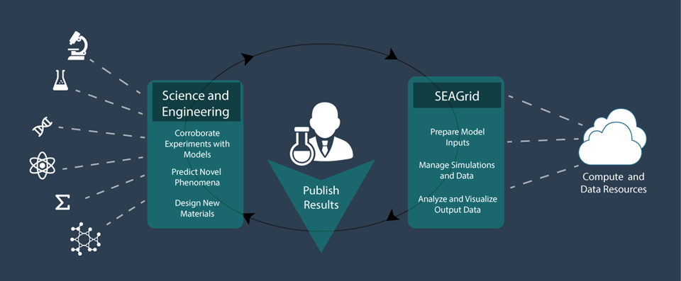
SEAGrid.org is an Apache Airavata-powered gateway

Slide 9
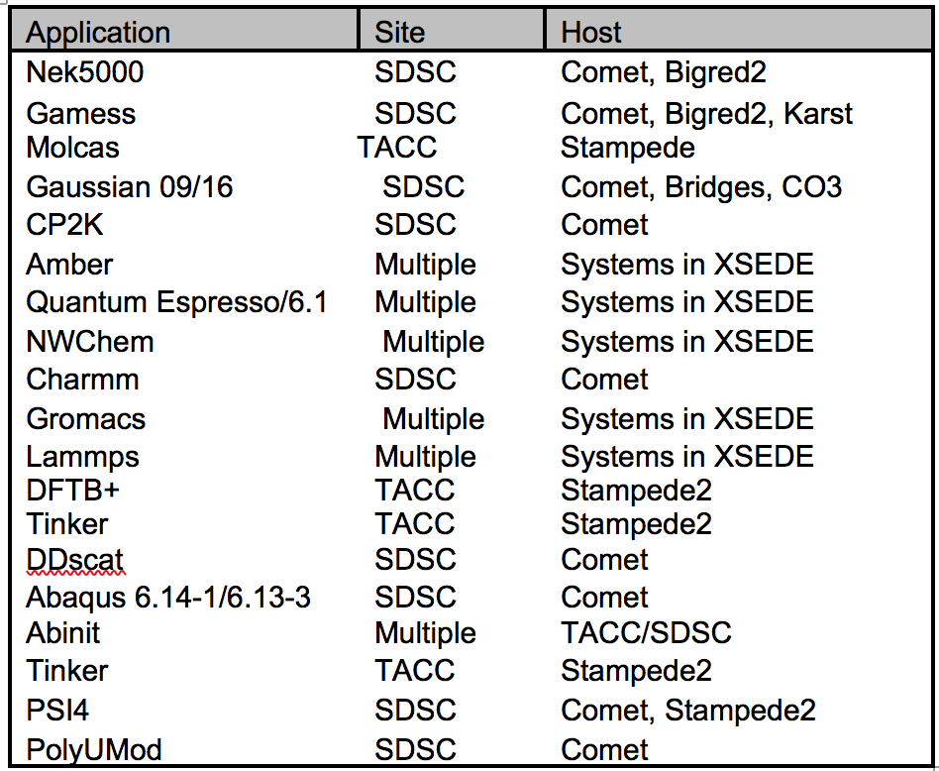
SEAGrid 12 Years in Service
NSF XSEDE Gateway Allocation
NSF XSEDE Resources SDSC, TACC, PSC, IU, LSU
Bigred2 (IU) and Karst (IU), Carbonate
900 Registered Users, ~ 150 Active
63M XD SUs for 70K Jobs Since 2015
More than 50 Publications since 2015
Mainly Chemistry Applications
Desktop Client for Pre and Post processing
Dynamic Information Services (RSS, HPC Load
data, Queue Prediction) Inherent workflow
capability – Checkpoint Reuse, High throughput
and Coupled Applications
Allocations, PI specific user and resource management and Job level usage monitoring
Consulting – Adaptive Services
Data Archive

Slide 10
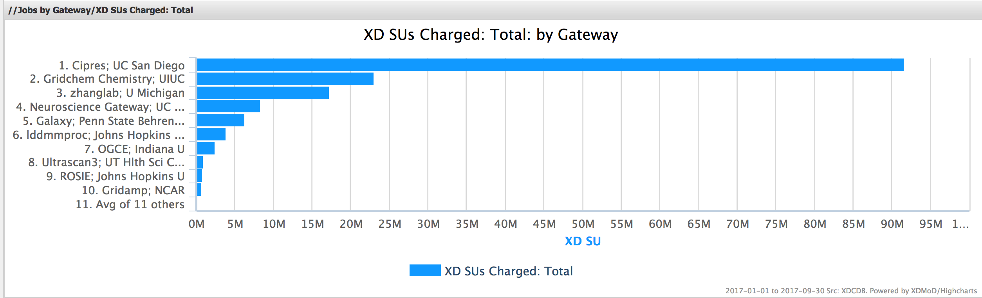
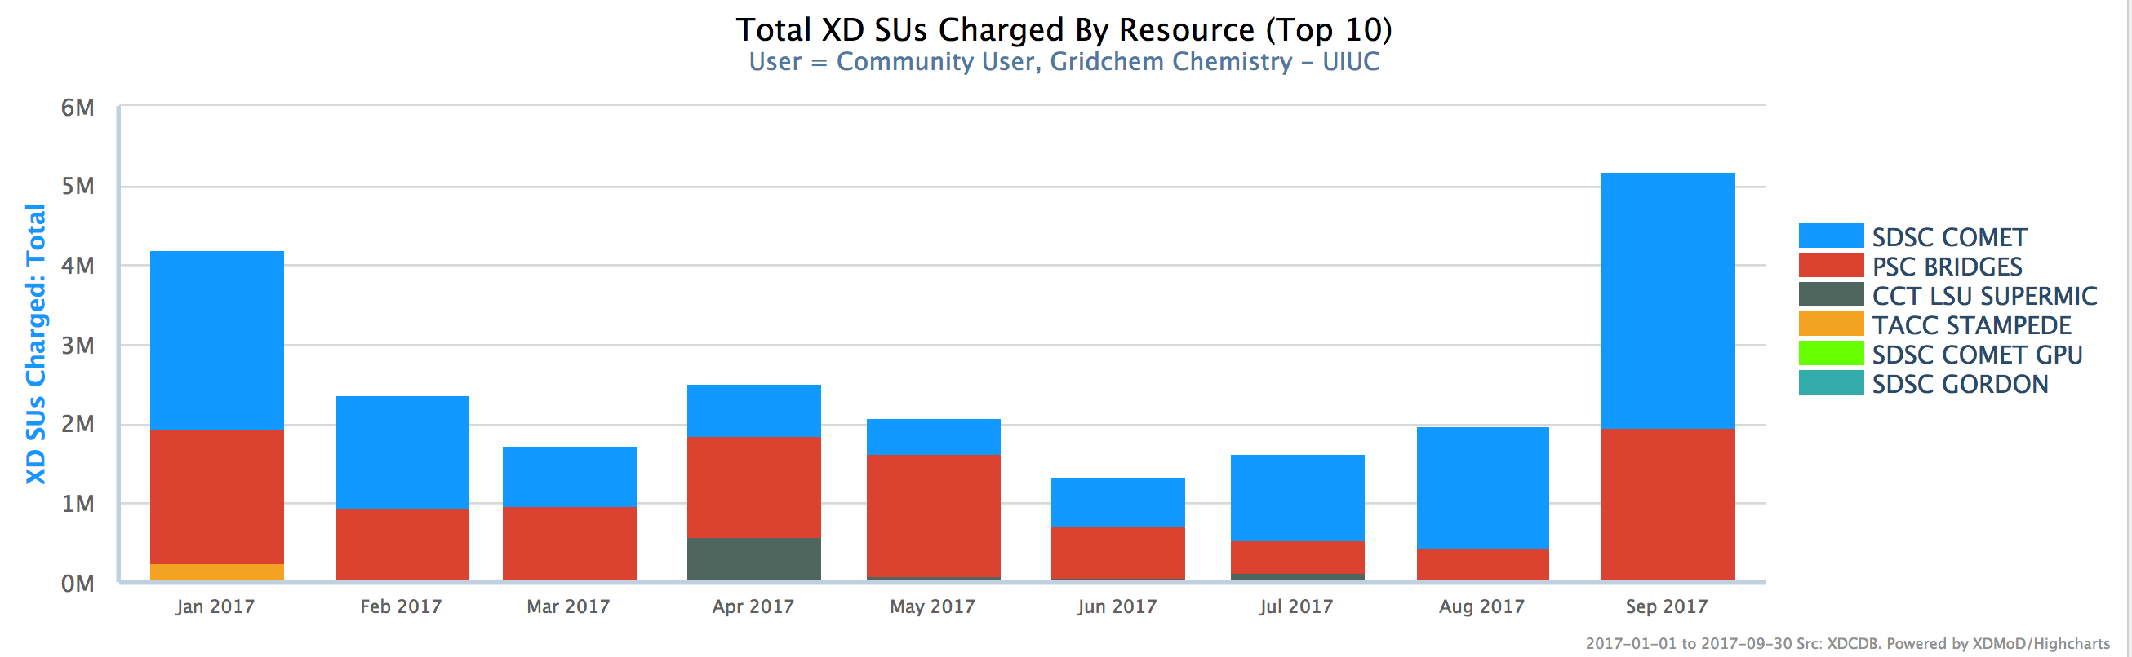
SEAGrid Usage

Slide 11
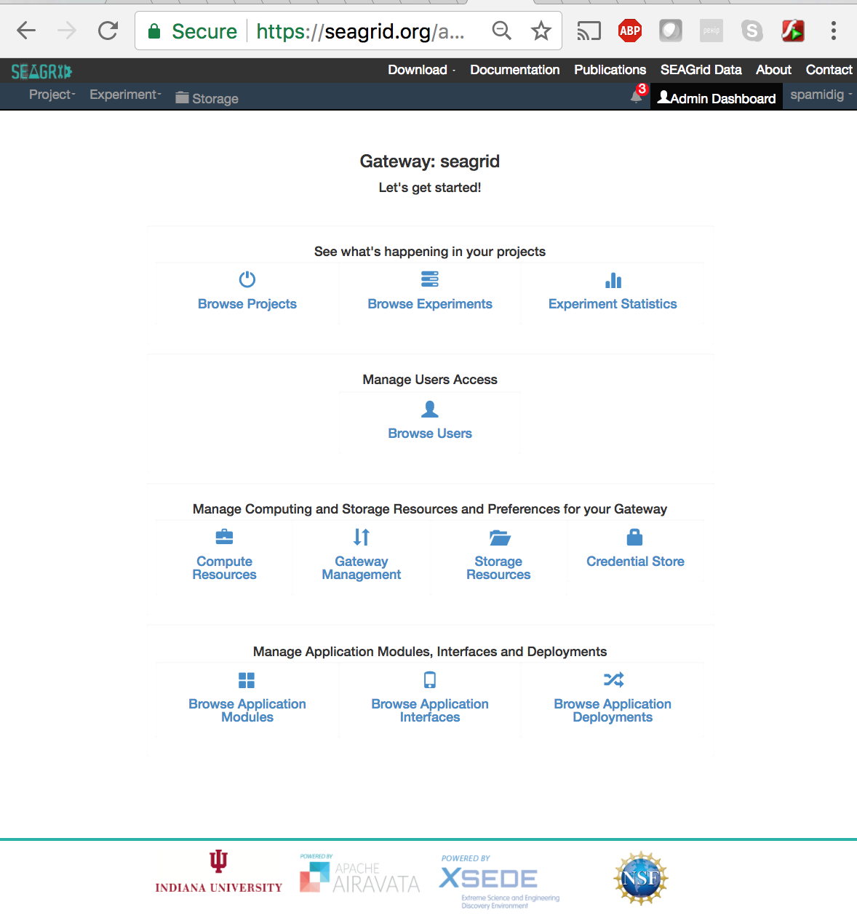
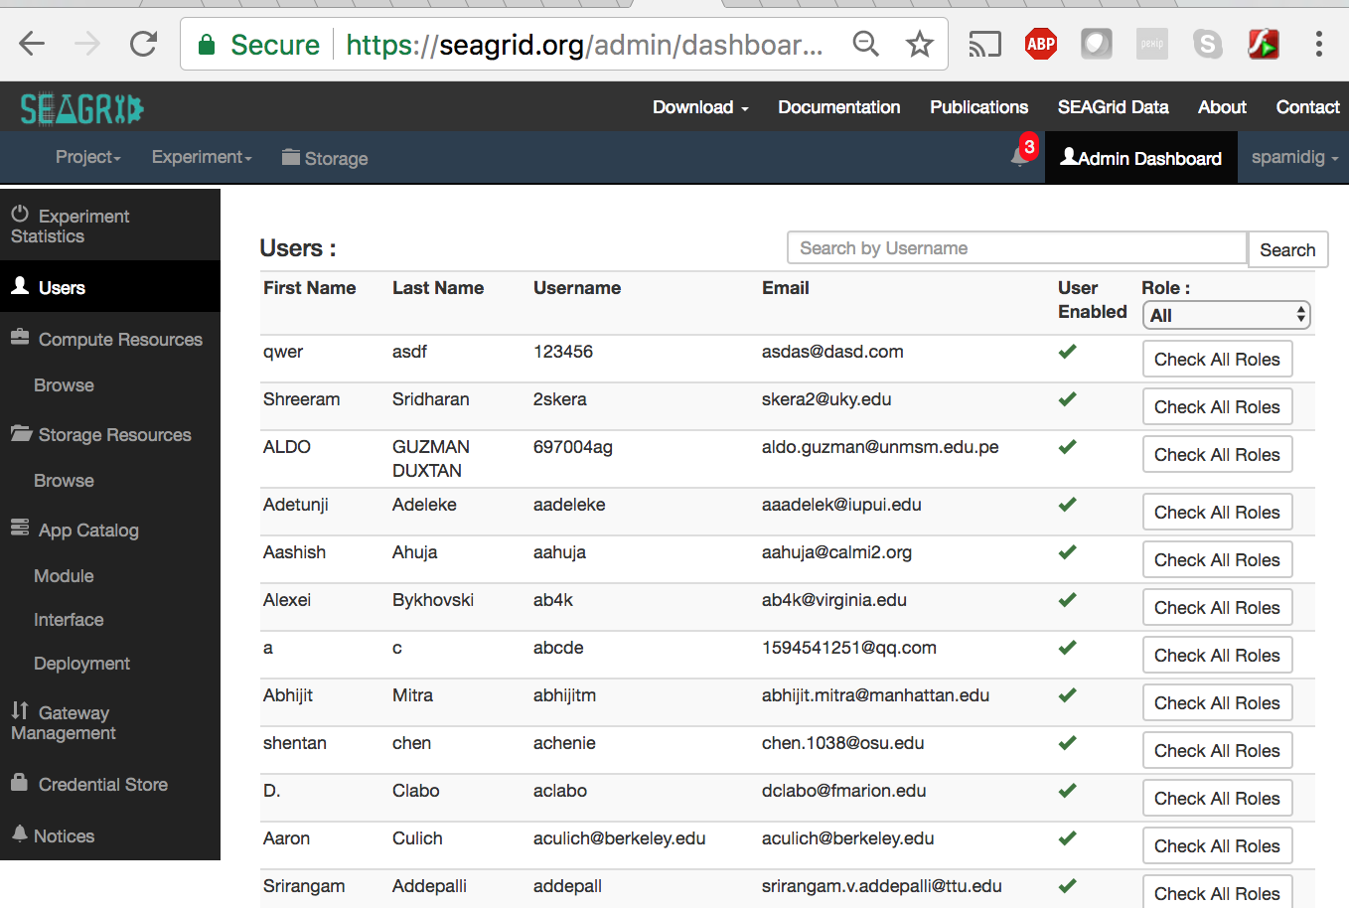
SEAGrid Gateway Admin View

Slide 12
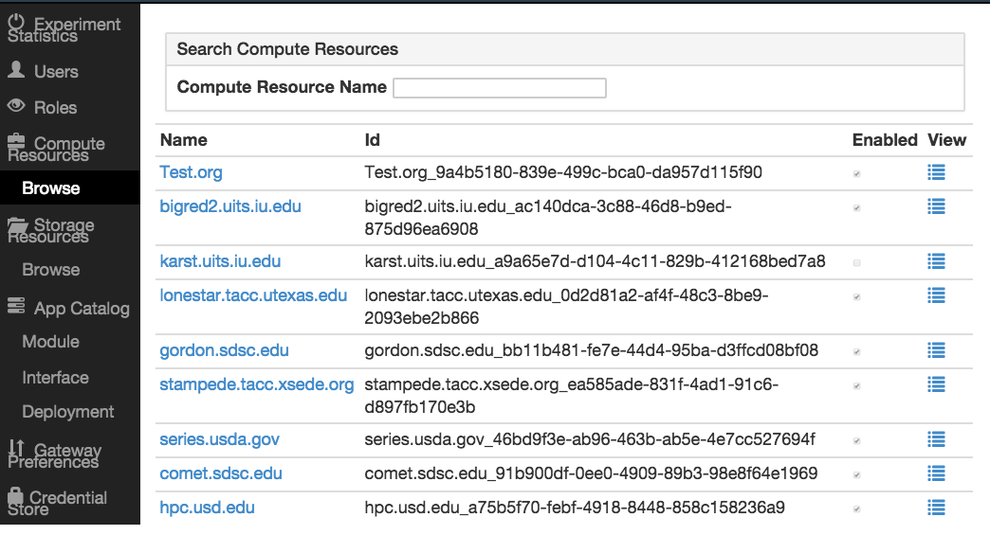
SEAGrid Admin Dashboard Compute Resource Browser

Slide 13
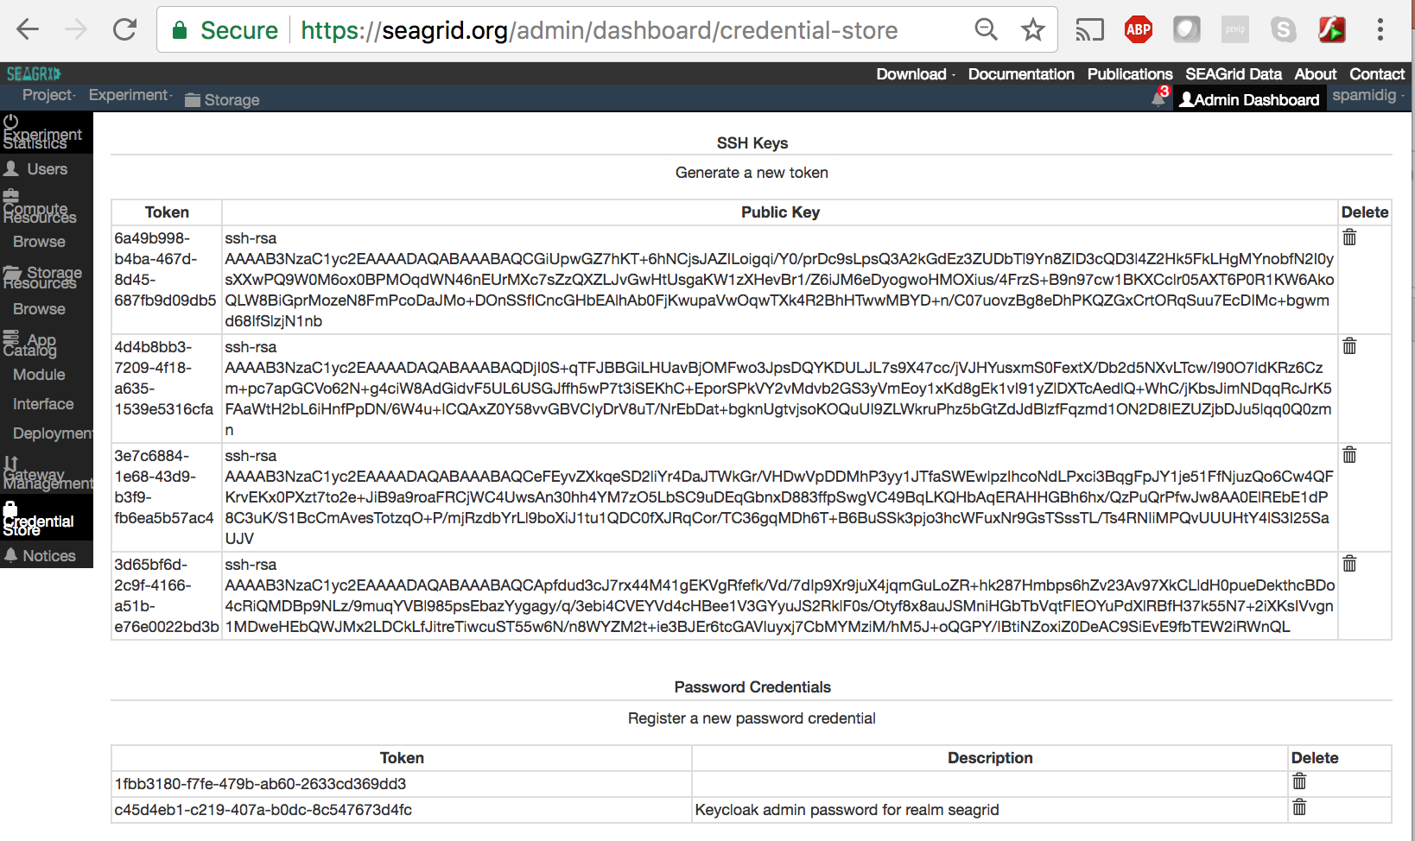
SEAGrid Gateway Credential Store

Slide 14
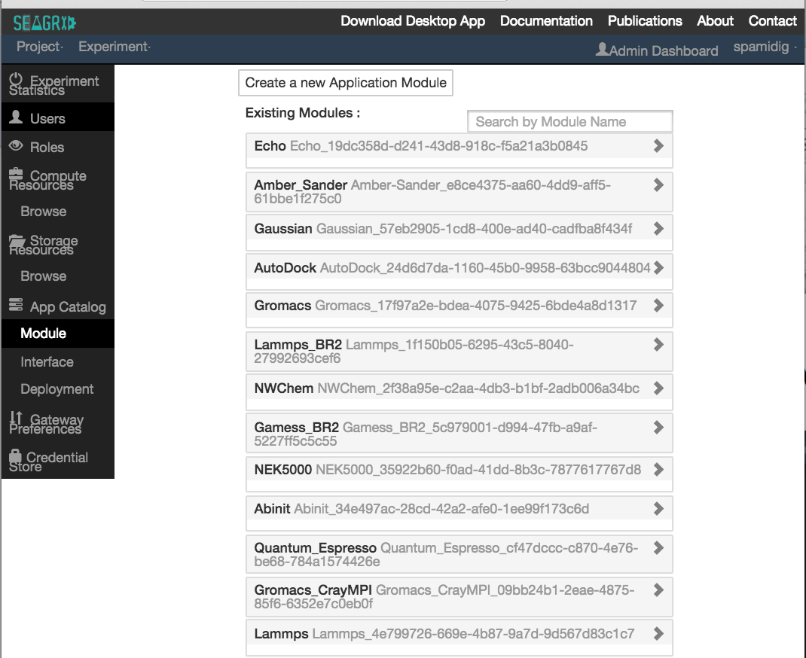
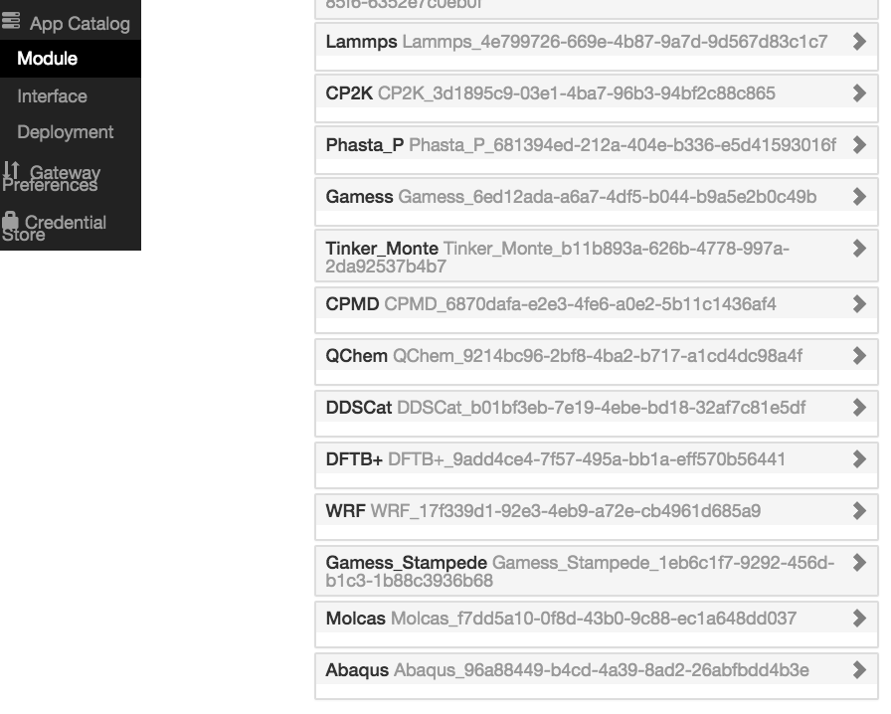
SEAGrid Application Catalog
Continued…

Slide 15
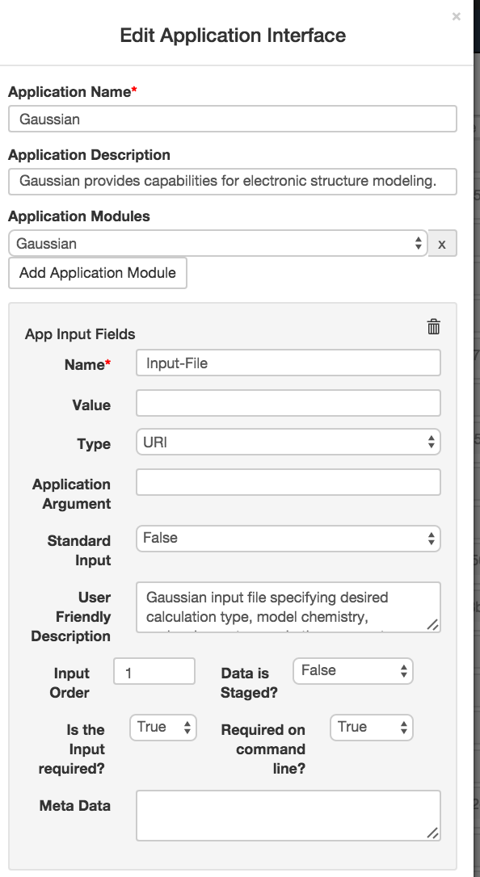
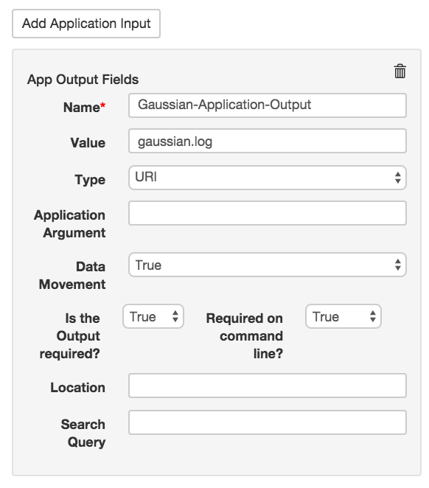
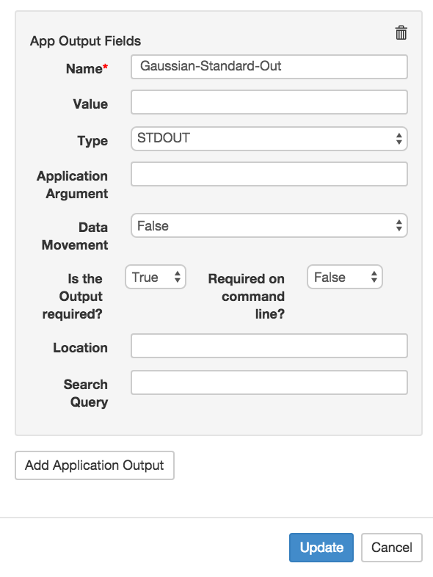
Application Interface Editor
Continued…

Slide 16
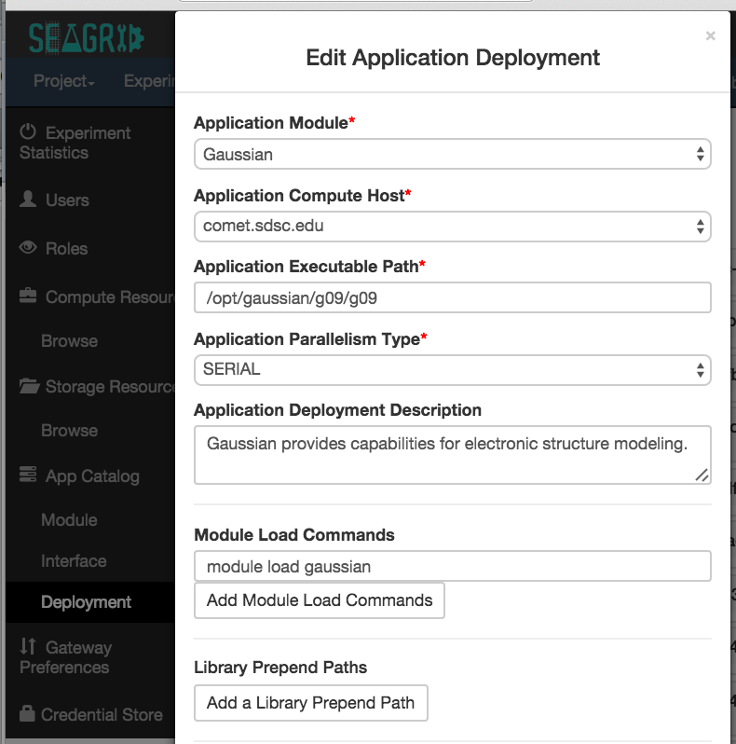
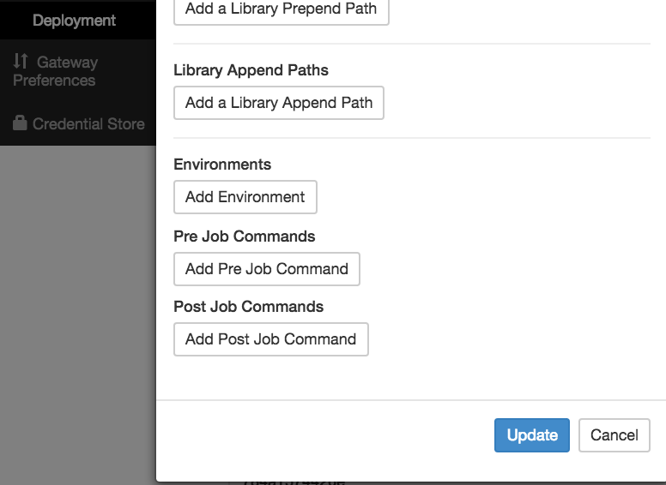
Application Deployment Editor
Continued…

Slide 17
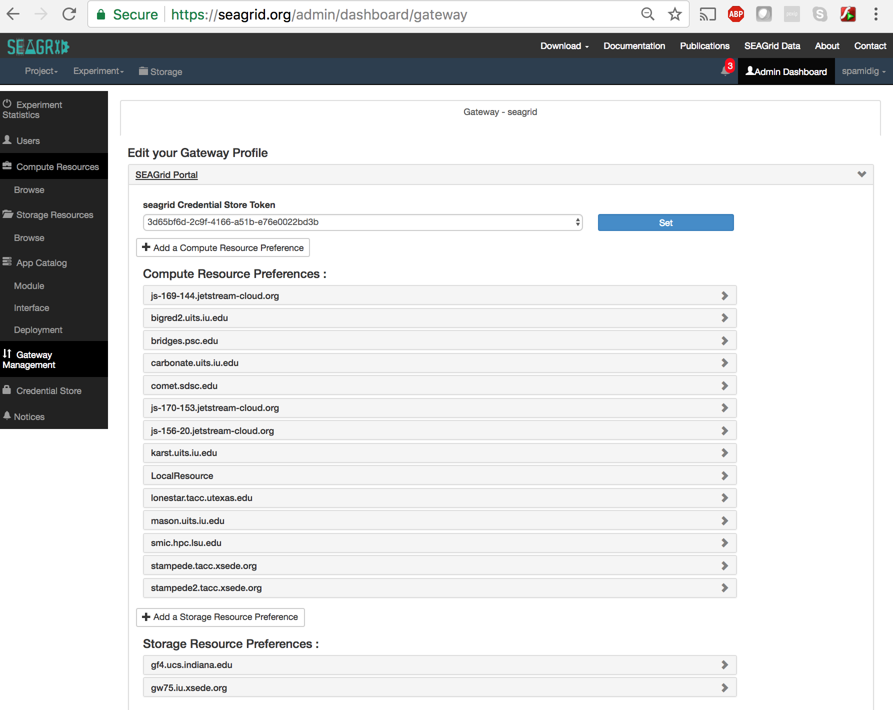
Gateway Profile

Slide 18
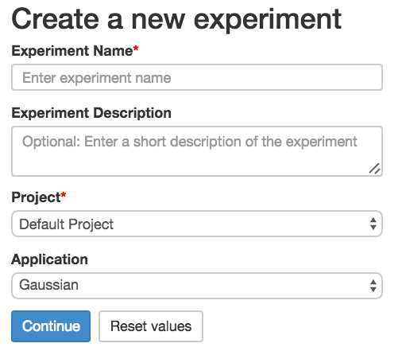
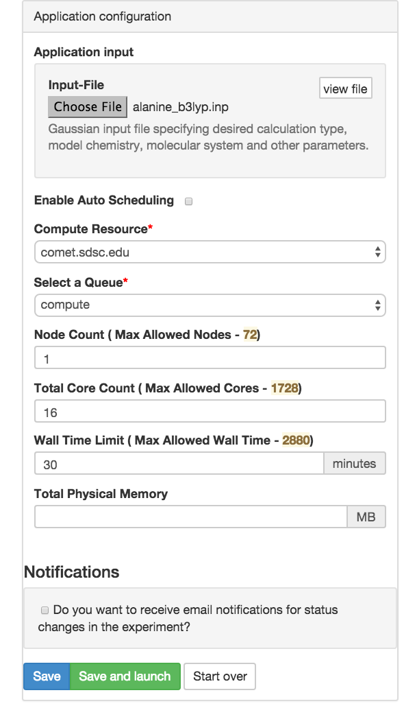
SEAGrid Experiment Creation

Slide 19
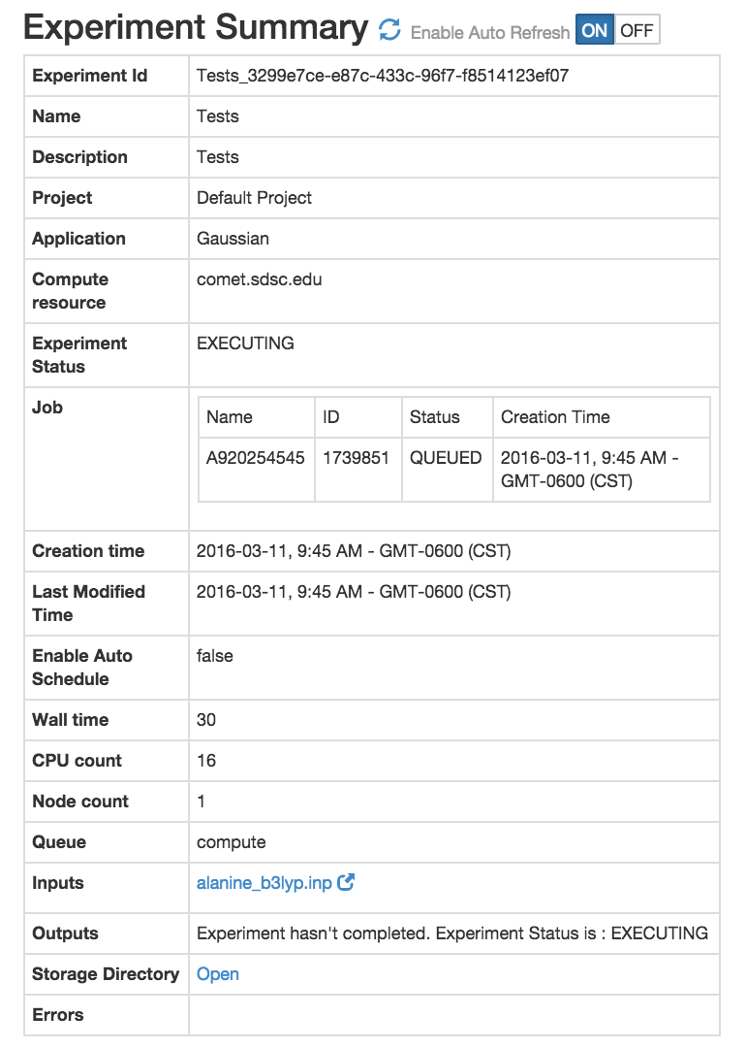
SEAGrid Experiment Status

Slide 20
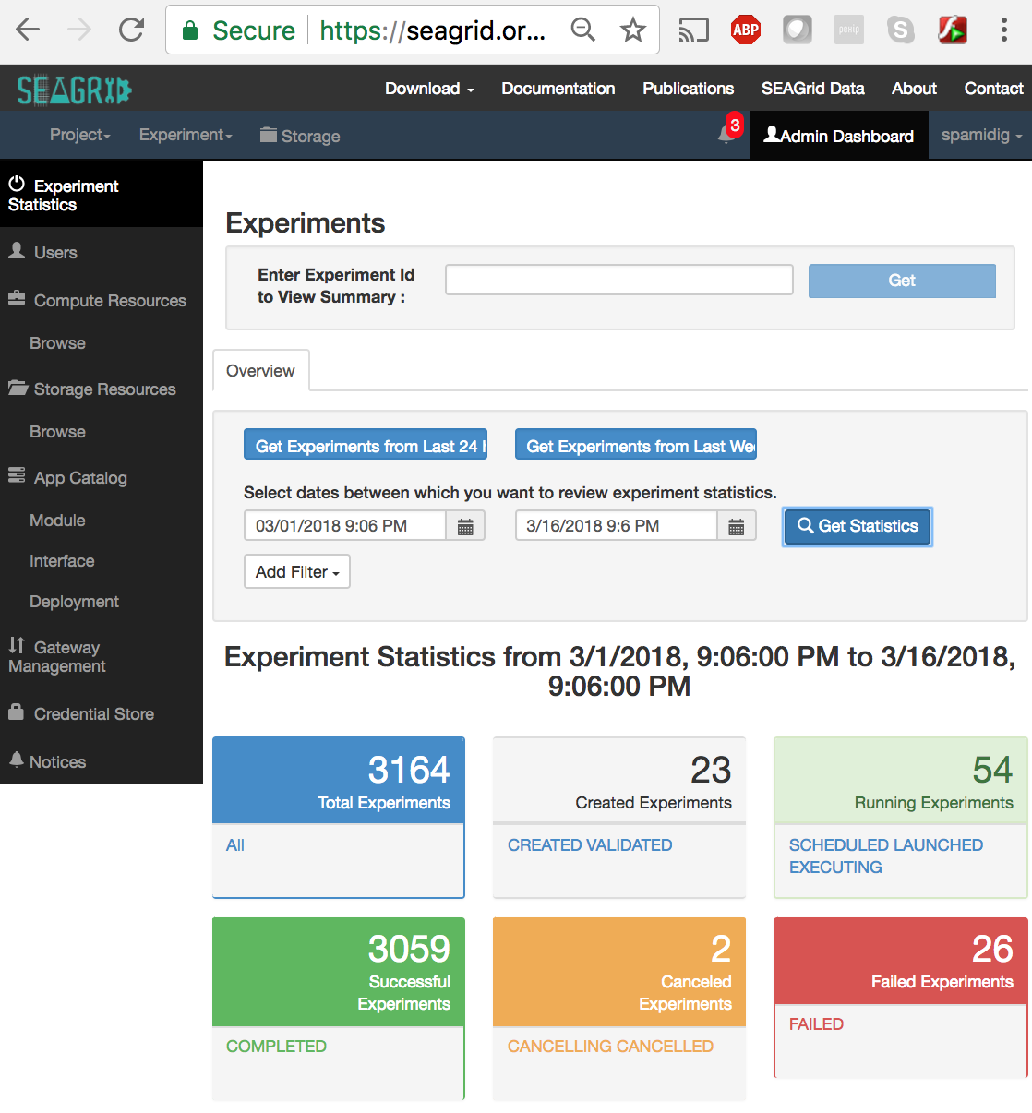
SEAGrid Admin Experiment Viewer

Slide 21
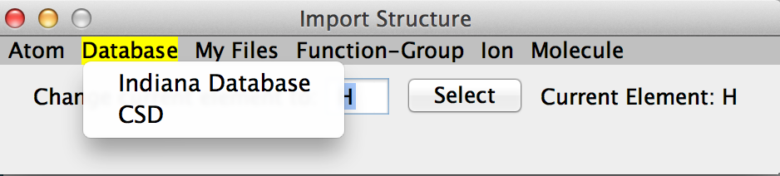
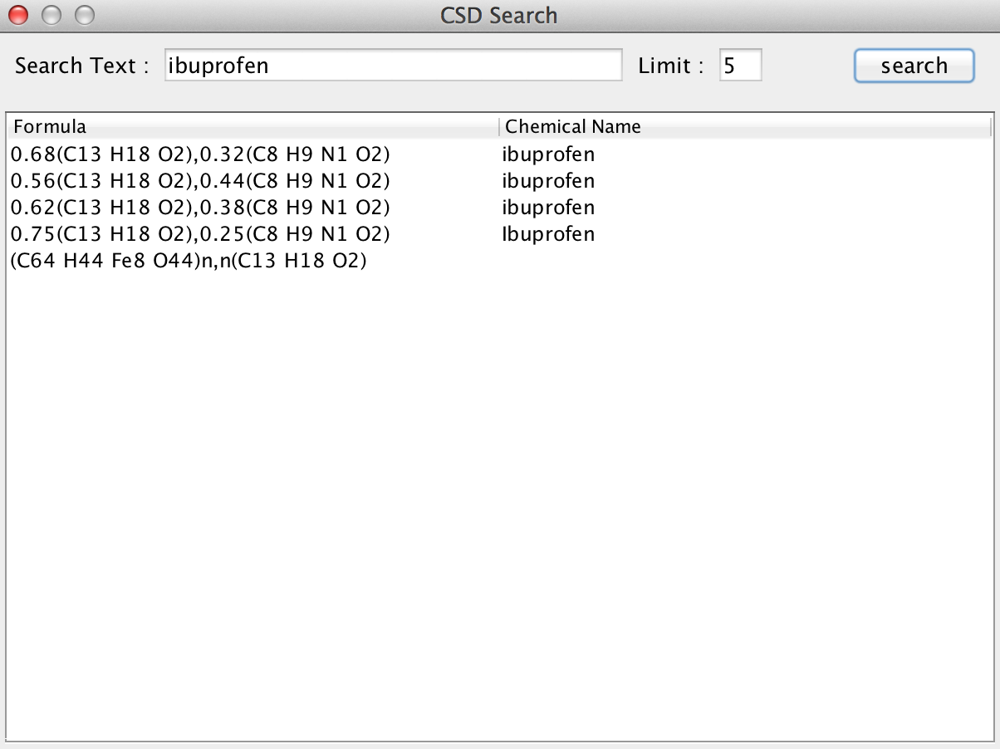
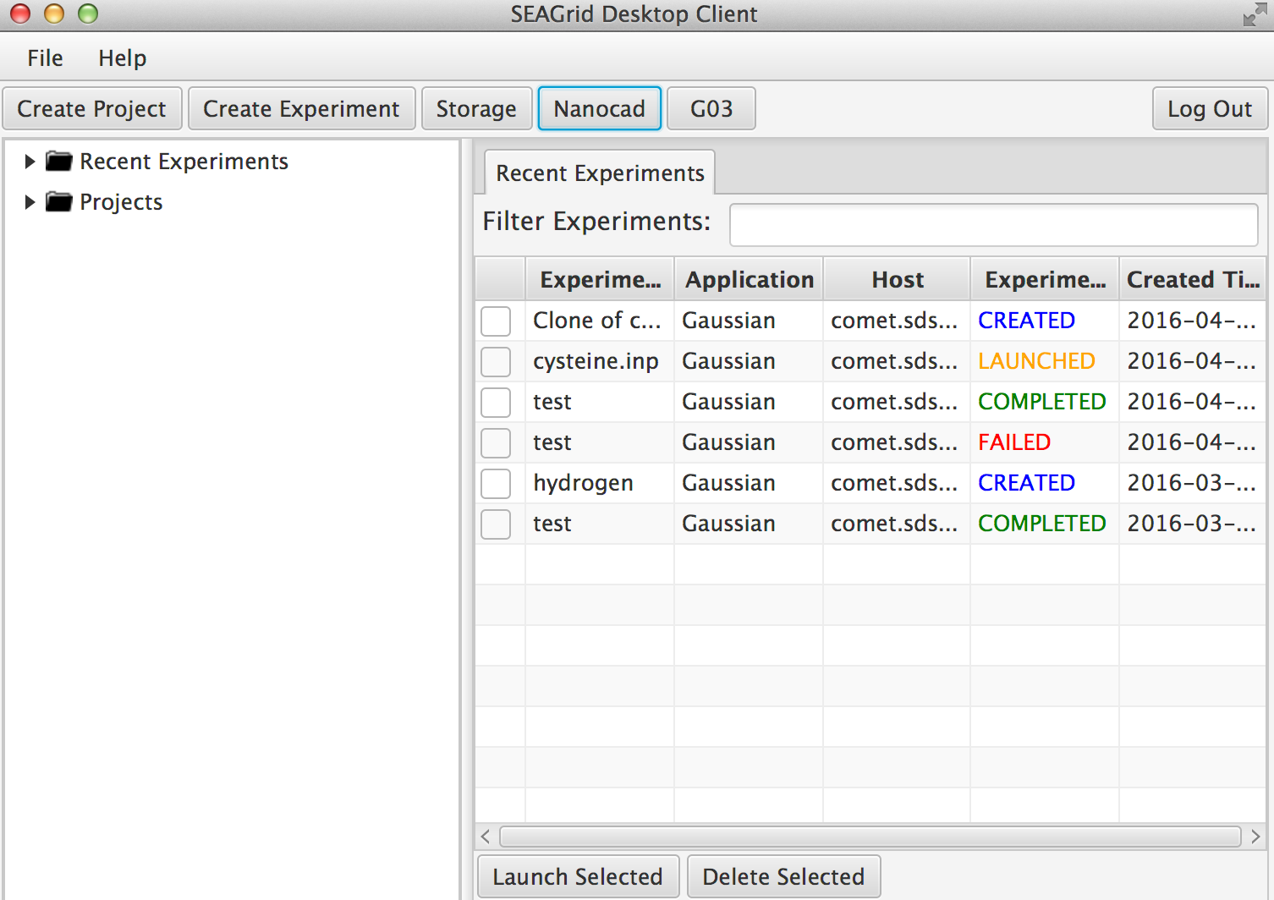
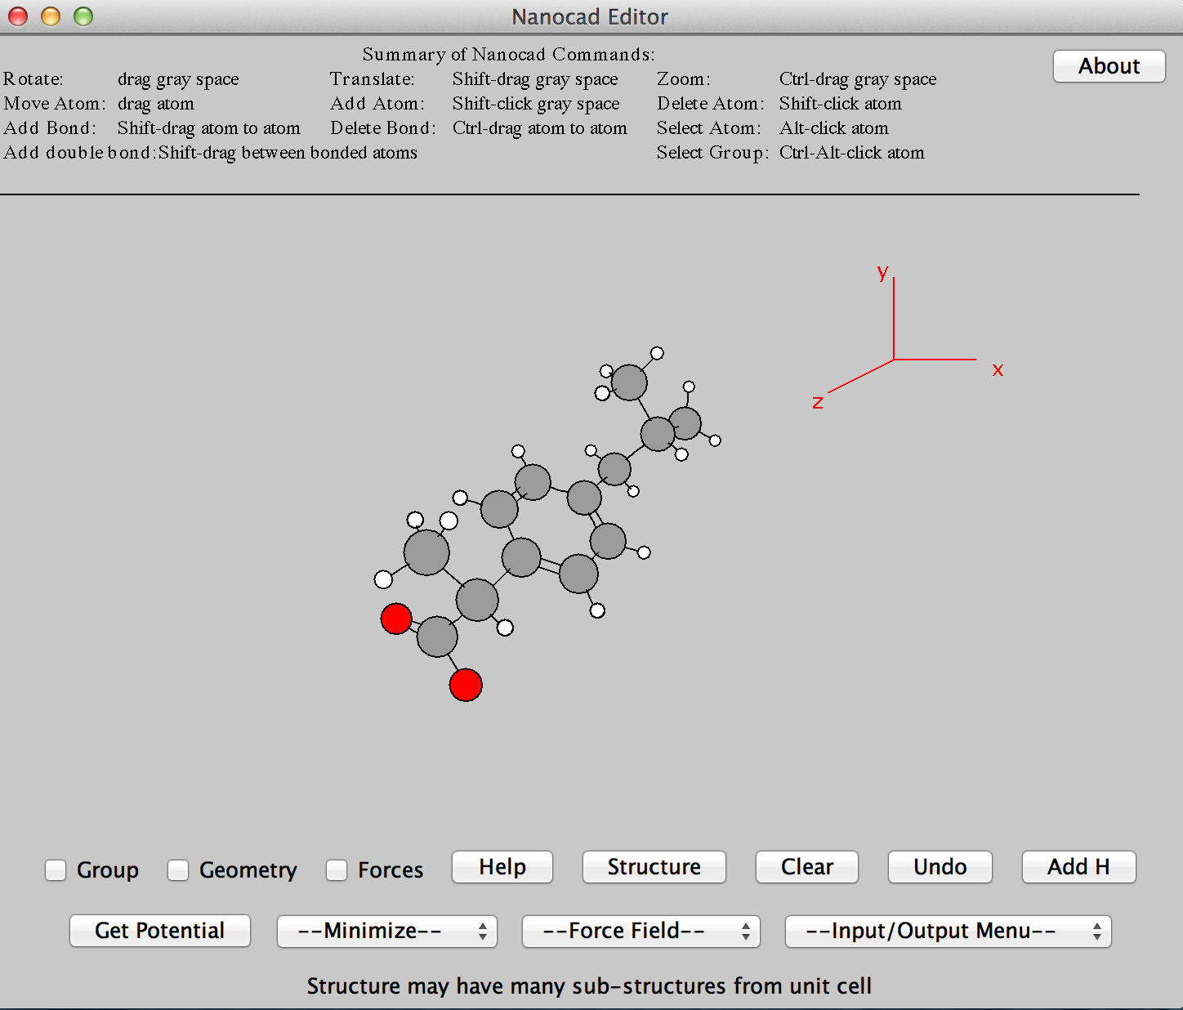
SEAGrid Desktop Client CSD Database Integration

Slide 22
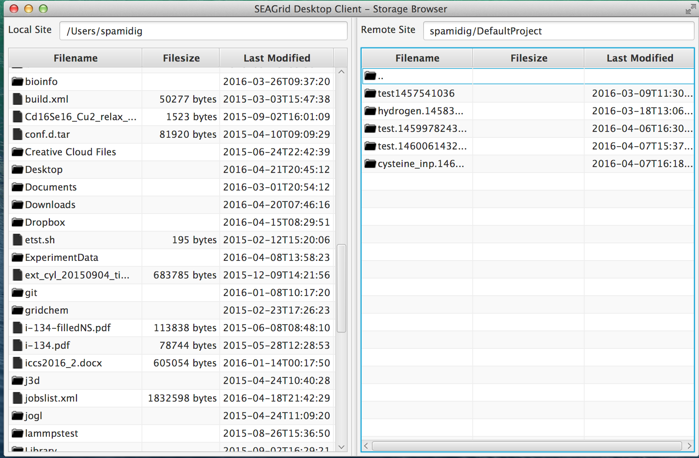
SEAGrid Desktop Client
Storage Browser

Slide 23
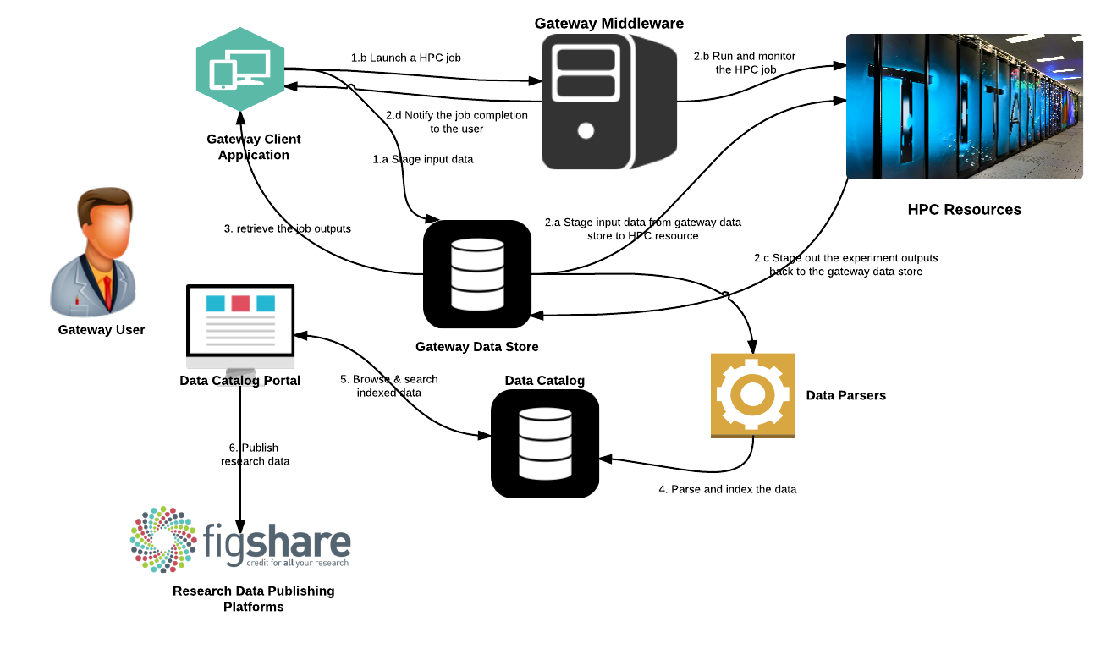

SEAGrid Data Catalog

Slide 24
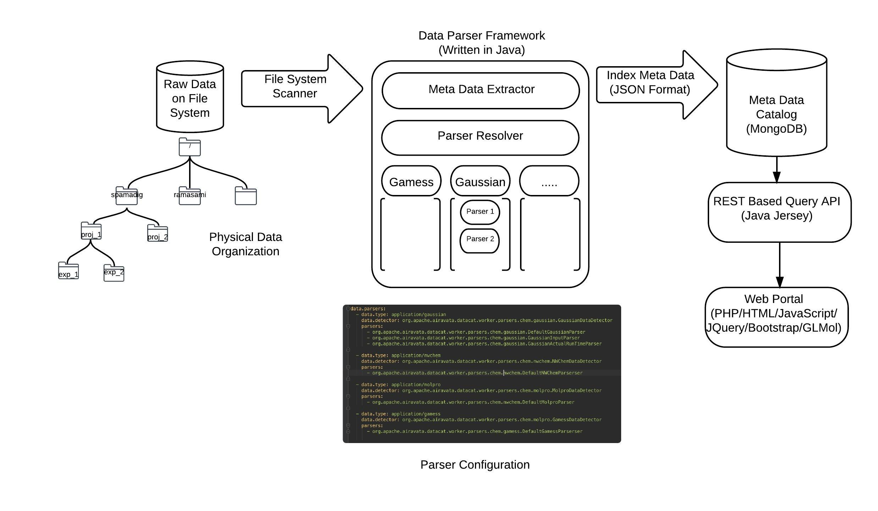
SEAGrid Data System Architecture

Slide 25
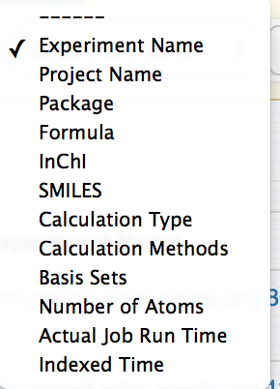
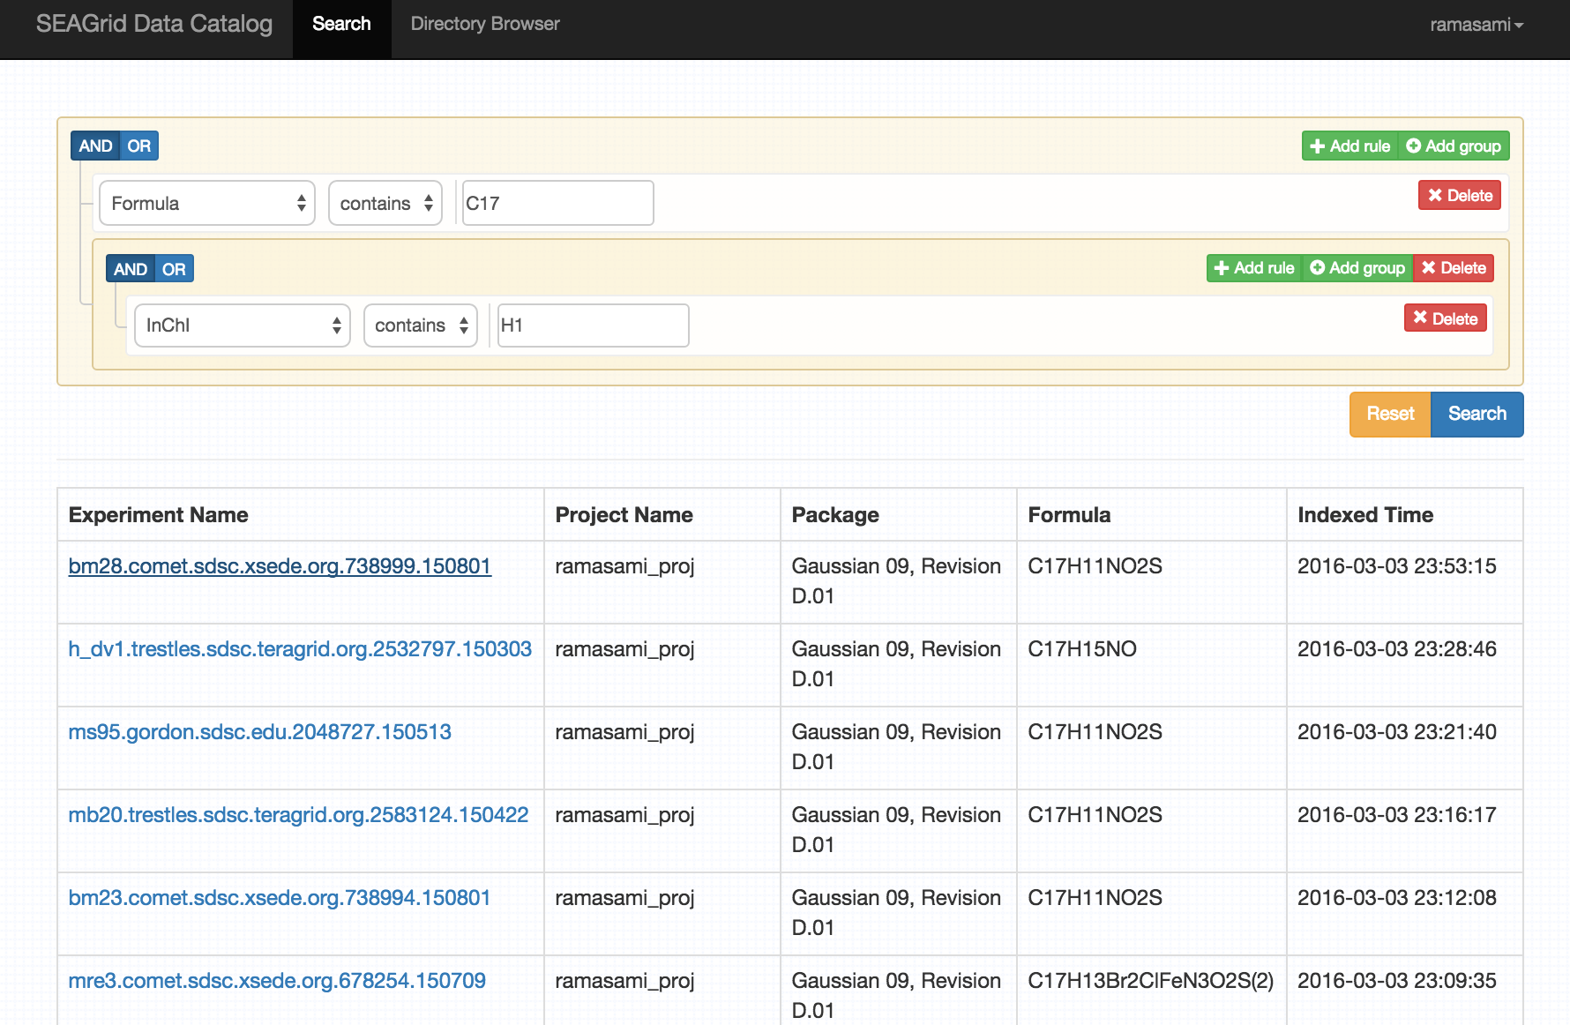
Searching for Cataloged Data

Slide 26
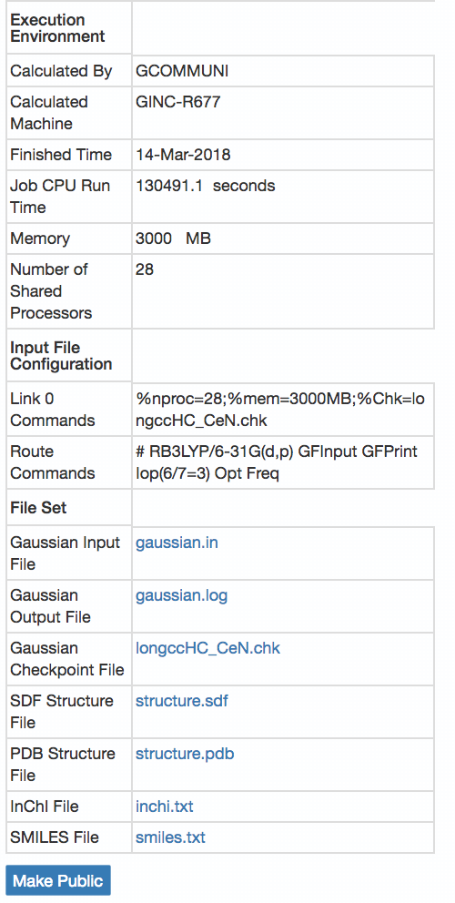
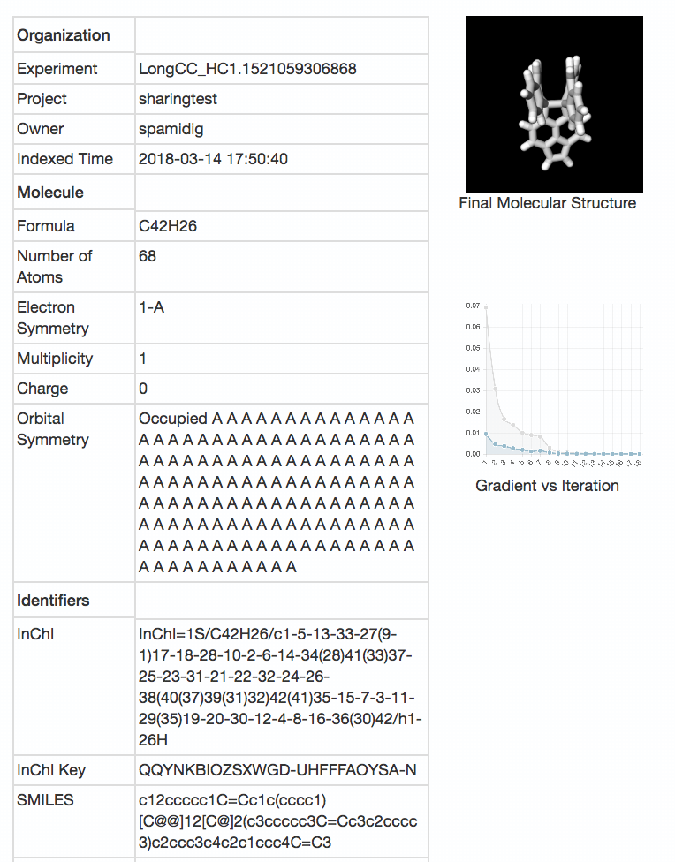
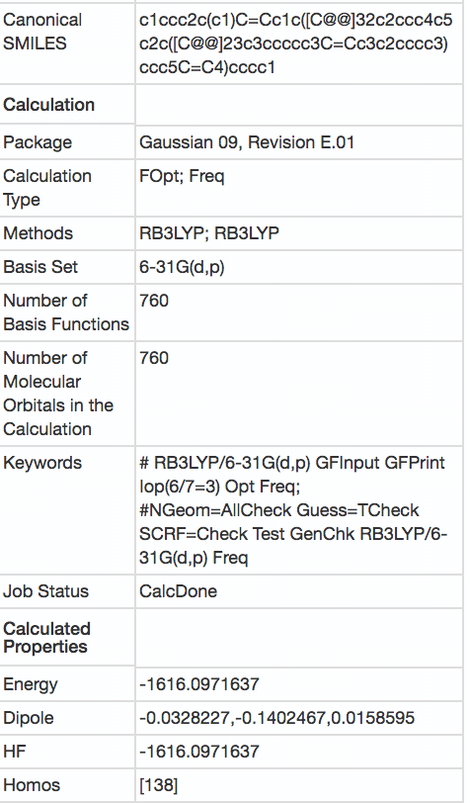
Output Metadata

Slide 27
Real Science with Science Gateways

Slide 28
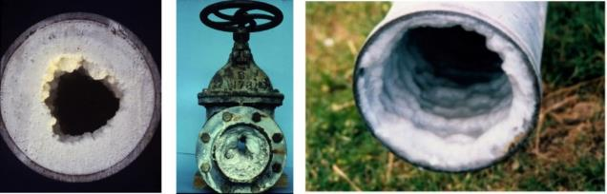
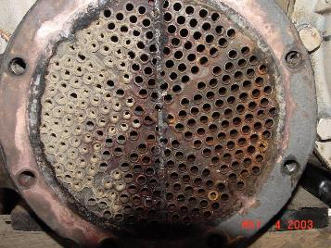
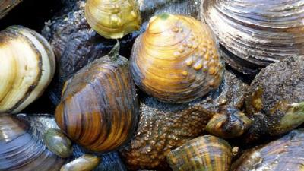
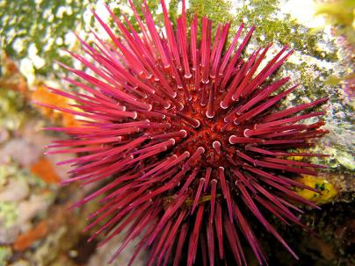
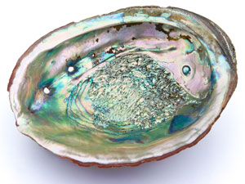
Biomineralization
Calcium Carbonate in Industrial Processes: Pipe scaling and Heat exchanger fouling
CaCO₃ enables: Tough structures Self-healing and Growth

Slide 29
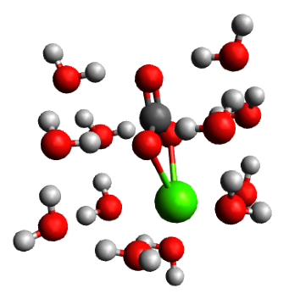
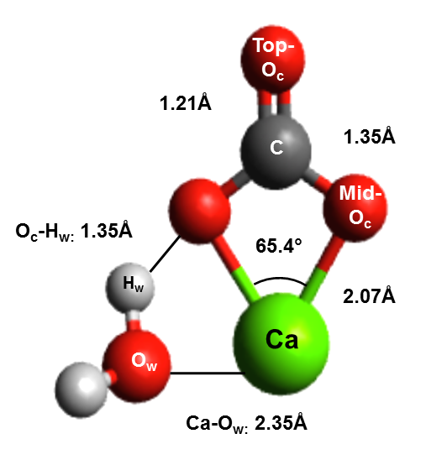
What is the chemistry of hydrated calcium carbonate?
Bio-mineralization of skeletons and shells
Geological C02 sequestration
Cleanup of contaminated environments
Lopez-Berganza, et al. J Phys. Chem. A(2015)
CaCO3.1H2O
CaCO3.12H2O

Slide 30

CaCO₃.xH₂O Initial guess
SEAGrid.org enabled workflow
Stampede Supercomputer
TINKER
Monte Carlo Molecular Mechanics
(Minimize Torsional Energy in <20,000 steps)
Stampede Supercomputer
DFTB+
Approximate DFT-Based
x=x+1
-2-3 CaCO3 Equilibrium Structures
-Thermochemistry (E,H,G, etc.)
-Vibrational Frequencies
Comet Supercomputer
Gaussian09
Ab initio Quantum Chemistry
Lopez-Berganza, et al. J Phys. Chem. A(2015)

Slide 31

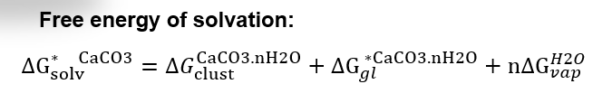
Bulk Solvation of Calcium Carbonate: PCM Solvation Model
Water Cavity
ε=80.1
Lopez-Berganza, et al. J Phys. Chem. A(2015)
Notes:
Finally we also placed our gas-phase clusteres in a water cavity to simulate the solvation of calcium carbonate in bulk water. We define the following thermodynamic cycle which shows the solvation steps of a hydrated clusters. If we can simulate the pieces of each corner, then we can obtain the solvation free energy of calcium carbonate. Which to best of our knowledge had not been reported.

Slide 32
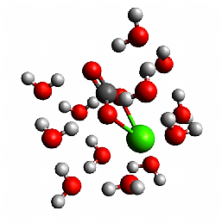
Calcium Carbonate Hydration Shell
CaCO₃.12H₂O
B3LYP 6-311G(d,p)
Lopez-Berganza, et al. J Phys. Chem. A(2015)
Notes:
These graphs shows a quick snapshot of our approach. For a hydrated caco3 clusters, we are able to determine its first hydration shell, look at the thermodynamics involved and calculate a solvation free energy. We now have a better idea of the energetics that may be involved in the initial stages of the formation of calcium carbonate.

Slide 33
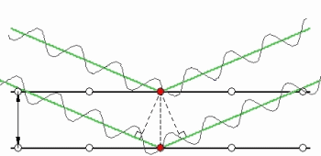
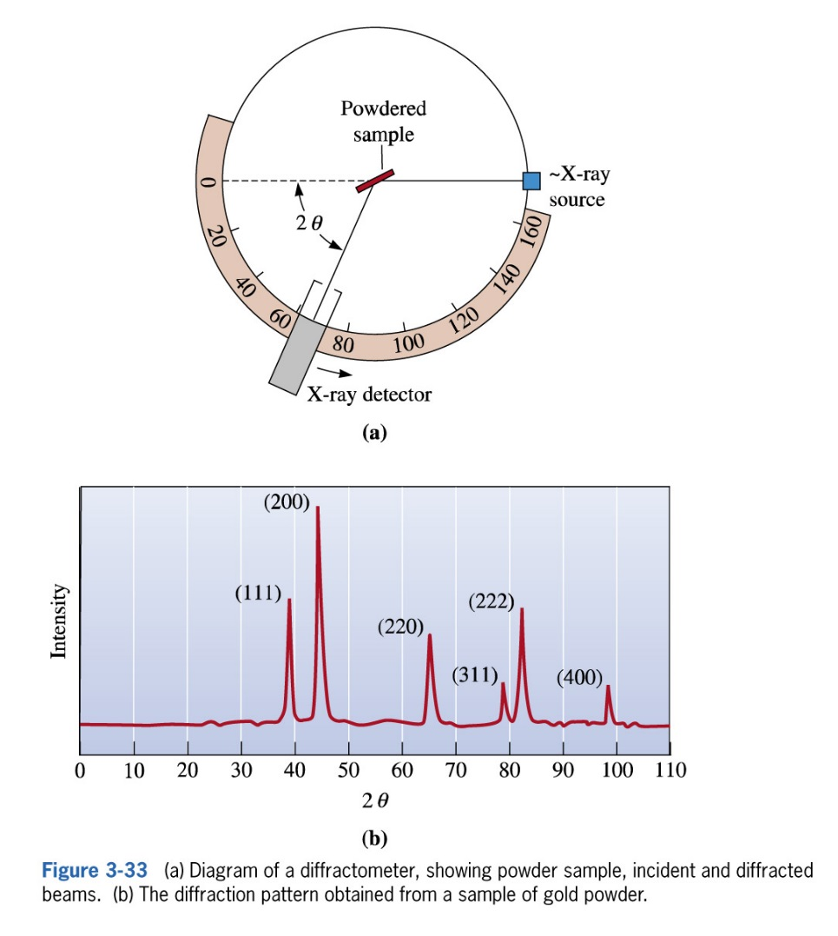
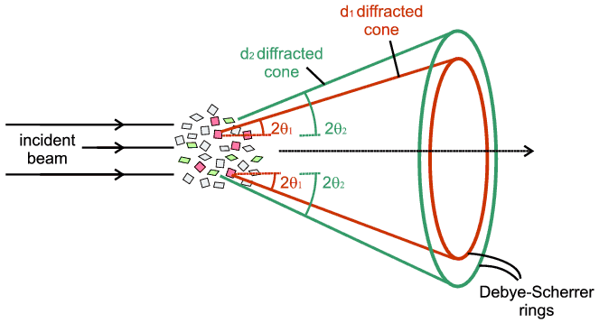
Lammps Diffraction Workflows
X-Ray and Electron Diffraction are common experimental techniques to determine the structure of a material
Example: X-Ray Powder Diffraction
    Constructive diffraction will occur at specific orientations between the material lattice and the incoming x-rays
    In powder diffraction, all orientations of the lattice are represented and the resulting diffraction pattern identifies the crystal structure
X-Ray Diffraction Pattern for Cu

Slide 34
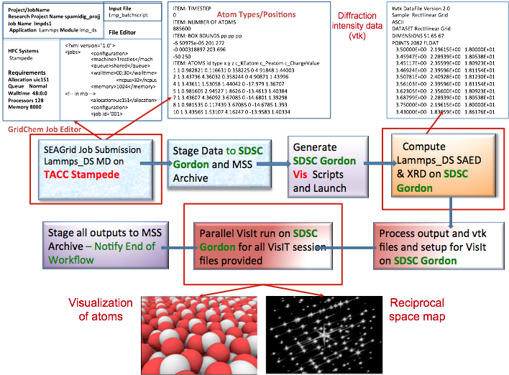
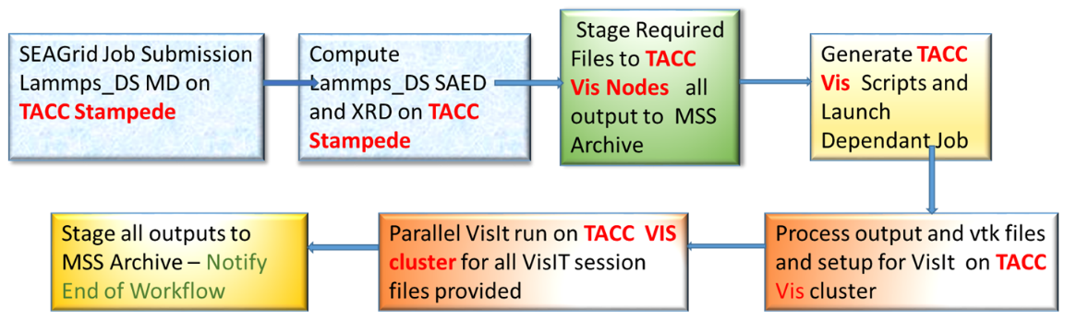
Workflow and Visualization
An XSEDE ECSS Project
For large memory calculations a workflow is required to use the appropriate XSEDE resource
  TACC Stampede: Atomistic simulation of alumina
  SDSC Gordon: Calculation of diffraction intensities + Visualization
Workflow implemented through SEAGrid Science gateway
  Supports a private “DS” LAMMPS build
  Supports single jobID handle for multiresource job submission
  Supports the development of a XML script for high throughput job submission
  Compatible with parallel VisIt executions so that diffraction pattern generation is automated
Workflow to run on TACC resources only
Workflow running on TACC and SDSC Resources

Slide 35
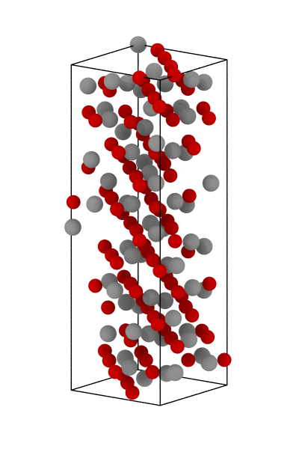
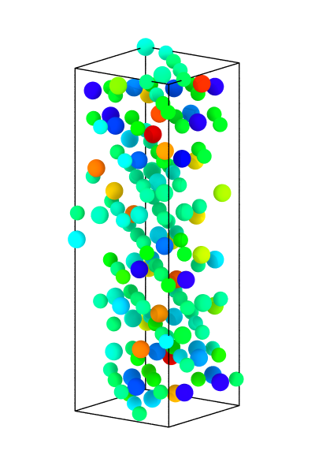











X-ray Diffraction of Bulk Alumina
  Characterization methods for non-cubic crystals in atomistic simulations are limited
Alumina Phases
    Centrosymmetry analysis shows no clear differentiation between phases
    Radial distribution function cannot differentiate between transition phases
γ
κ
α
θ
XRD
of Alumina Phases
SAED and HRTEM
of 120° twining in κ-Al₂O₃
Centrosymmetry(Å²)
0
5
10
15
20
Radial Distribution Functions
  Our objective is to develop an atomistic method to compute x-ray and electron diffraction patterns
(Santos et al. 2000)
(Ollivier et al. 1997)

Slide 36












Application: Phase Identification in Alumina
Virtual diffraction can distinguish between alumina phases
γ
κ
α
  Al₂O₃ phases modeled with the ReaxFF potential
  (Sen et al. 2013)
θ
Intensity
Intensity
Ishizawa (1979)
Ollivier (1997)
Intensity
Intensity
Coleman and Spearot (2014) Acta Materialia, Volume 82, 1 January 2015, Pages 403–413
.
Husson (1996)
Verwey (1935)

Slide 37


Line profiles, Structures and SAED Patterns for heterogonous α-Al2O3 (0001)/γ-Al2O3 (111) interface
Coleman et al. 2014, JOM 66, 408
The colored triangles are positioned at experimentally determined peak locations for bulk α-Al2O3 (red) and γ-Al2O3 (green)33.
Notes:
What are circles?

Slide 38
Acknowledgements and Contacts
NSF Grants ACI-1547611, ACI-1339774
Apache Software Foundation
Indiana University
GSOC Program
Science Gateways Research Center https://sgrc.iu.edu/
  Center email: sgrc-iu-group@iu.edu
  Marlon Pierce: marpierc@iu.edu, Director
  Apache Airavata Open Source Science Gateway Softwar http://airavata.apache.org/
  Sudhakar Pamidighantam pamidigs@iu.edu SEAGrid
  Suresh Marru: smarru@iu.edu Apache Airavata

